Slide 1
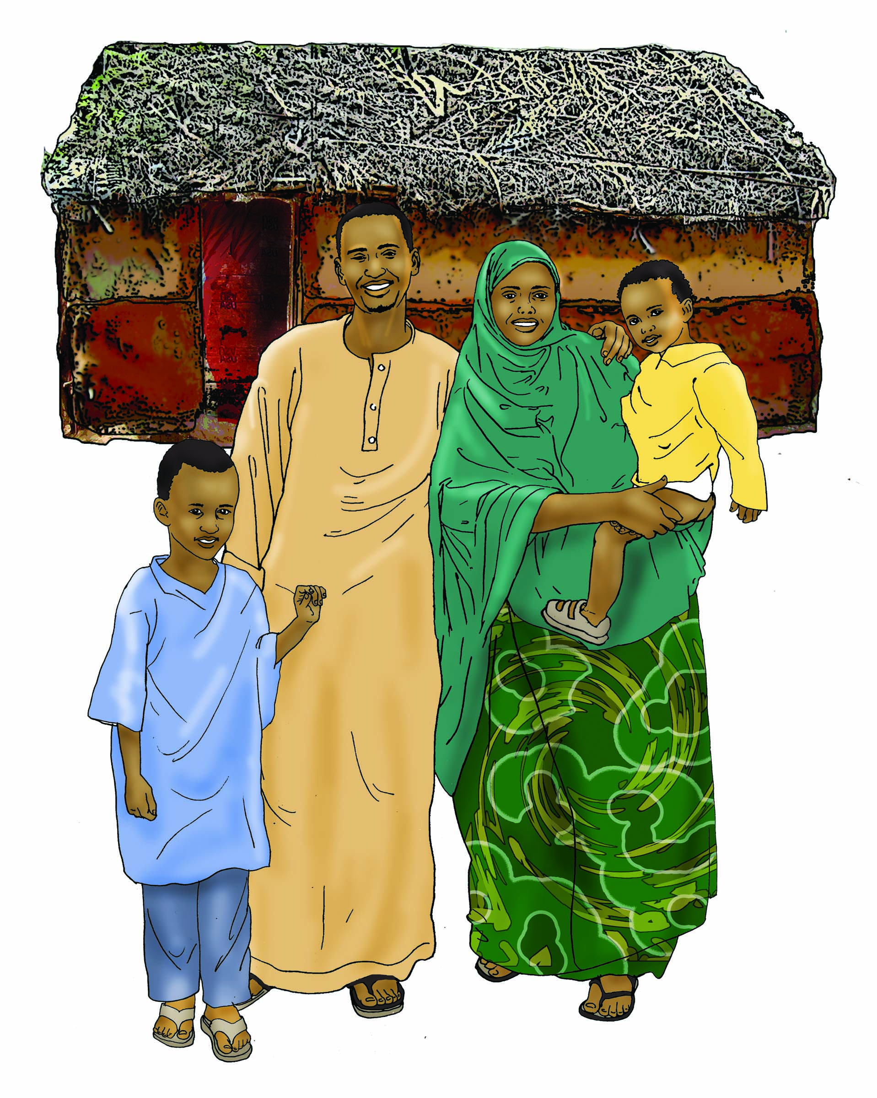
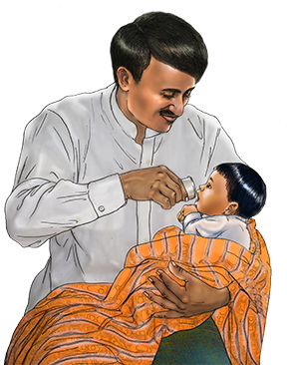
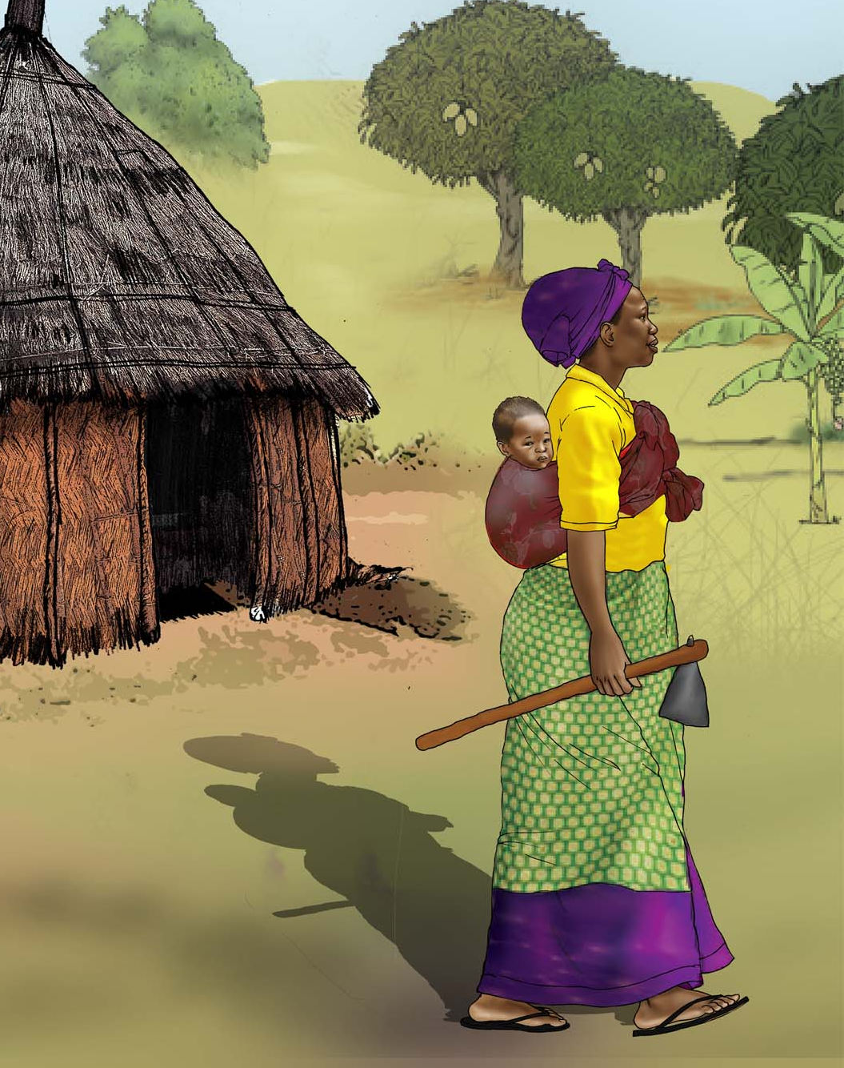
Strengthening Agriculture-Nutrition Linkages: Why It Matters
SPRING Nutrition-Sensitive Agriculture Training Resource Package
February 2018
The images on this slide were developed by a partnership between the USAID-funded SPRING project, the United Nations Children’s Fund (UNICEF), and University Research Co., LLC-Center for Human Services (URC-CHS). All images can be found in the IYCF image bank here: https://iycf.spring-nutrition.org/.
Notes:
Guidance for how to present these slides is included in the SPRING Nutrition-Sensitive Agriculture Training Resource Package Session Guide: 1 Guide- Why It Matters

Slide 2
Nutrition-Sensitive Agriculture: The Full Program
One
Two
Three
Four
Five
Six
Seven
Why Nutrition-Sensitive Agriculture Matters
Essential Nutrition Concepts
Essential Concepts in Agriculture & Food Security
Agriculture-to-Nutrition Pathways
Developing a Seasonal Calendar
Social Behavior Change
Designing Nutrition-Sensitive Activities

Slide 3
Session Objectives
Articulate key information on the social and economic impact of malnutrition
Explain why a multi-sectoral approach to address malnutrition is needed
Introduce the concept of nutrition-sensitive agriculture
Outline specific ways that agriculture can support improved nutrition

Slide 4
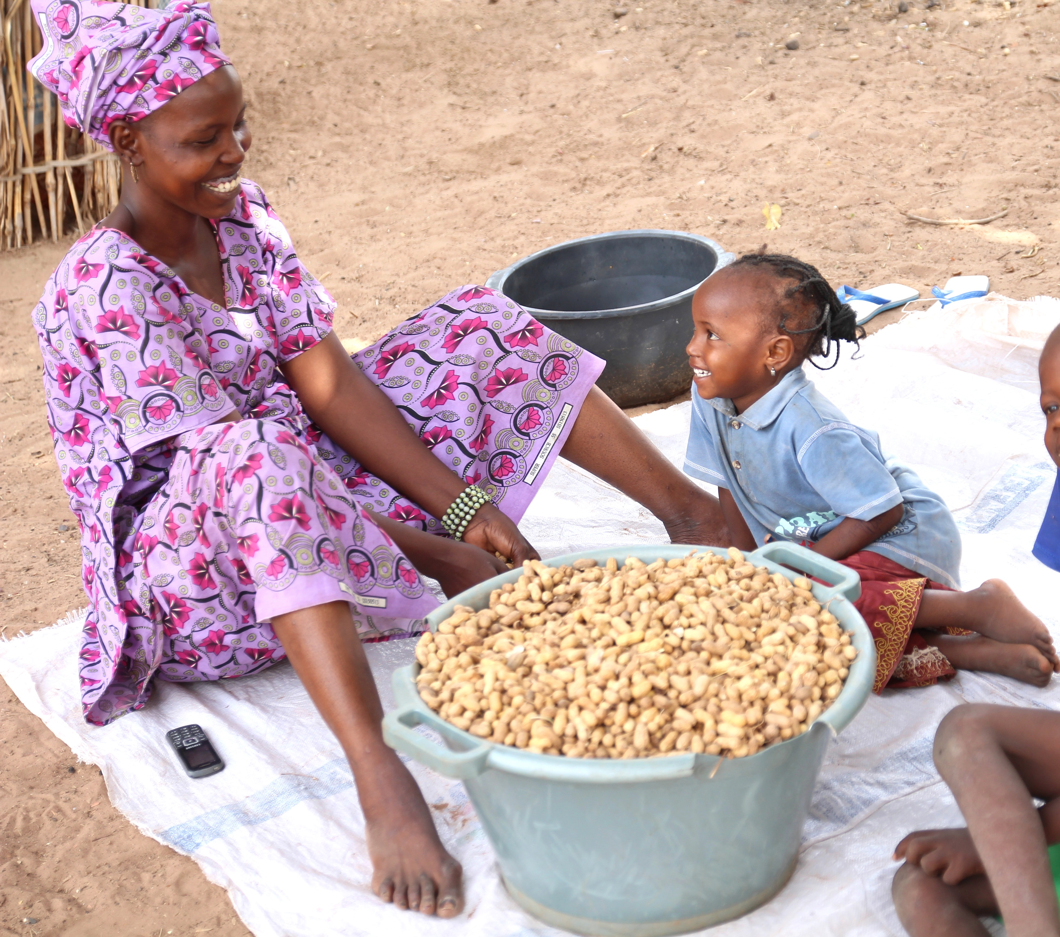
Why should the agriculture sector care about nutrition?
45% of child deaths are due to undernutrition.
There are many short-term and long-term consequences.
Photo credit: SPRING/Senegal
Source: IFPRI 2016.
Notes:
International Food Policy Research Institute. 2016. Global Nutrition Report 2016: From Promise to Impact: Ending Malnutrition by 2030. Washington, D.C.

Slide 5
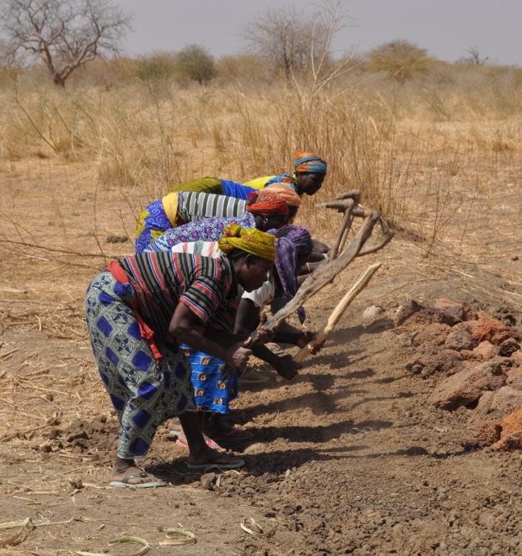
Cost of Malnutrition
5
Malnutrition leads to …
Decreased educational performance
Reduced work productivity
Reduced earnings
Poor nutrition has macroeconomic effects– 11% of GNP lost every year
Source: Black et al. 2013; Lim et al. 2012; Horton and Steckel 2013; IFPRI 2016.
Photo credit: J. Hartl, USAID

Slide 6
Improved Nutrition Drives Economic Growth
Better nutrition
Return = $16
Investment = $1
Economic development
Source: IFPRI 2016; Hoddinott 2016.
Notes:
6

Slide 7
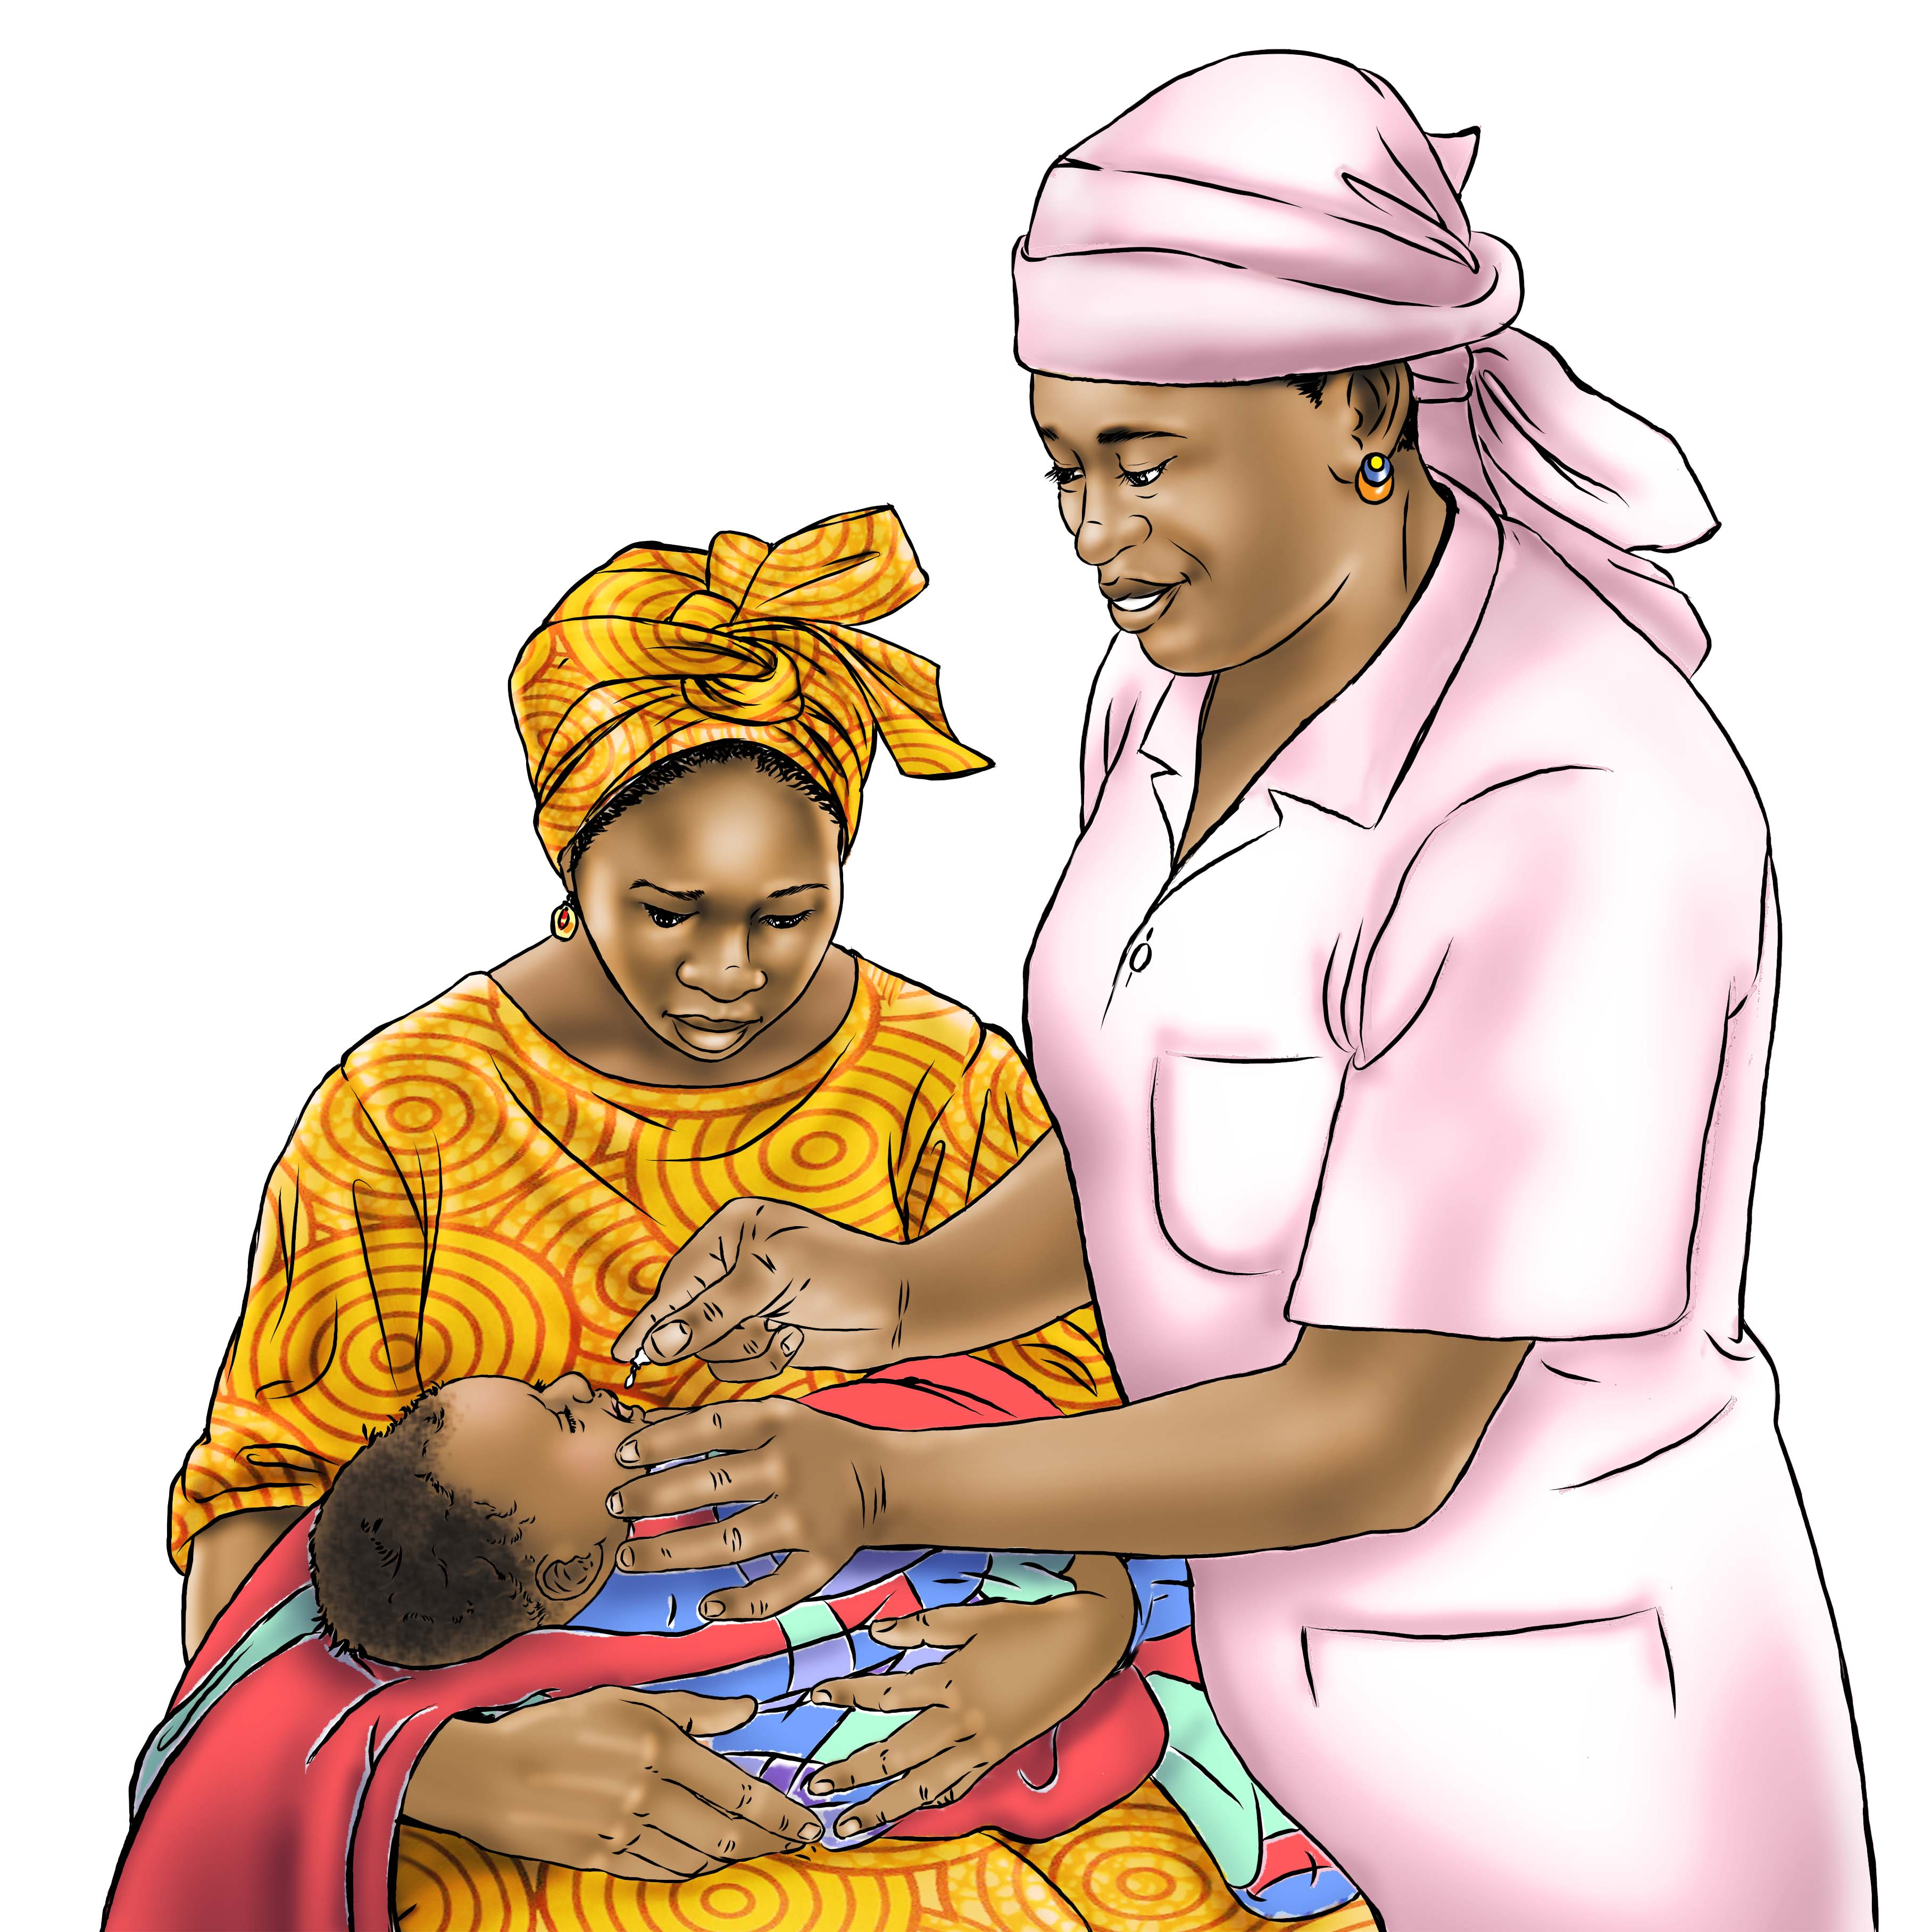
What works to reduce undernutrition? Nutrition-Specific Interventions
Promotion of correct breastfeeding, vitamin A supplementation, etc.
These address the immediate causes of undernutrition, including health status and nutrient intake.
Source: Black et al. 2013.
Image credit: SPRING
Notes:
Black et al. Lancet 2013

Slide 8
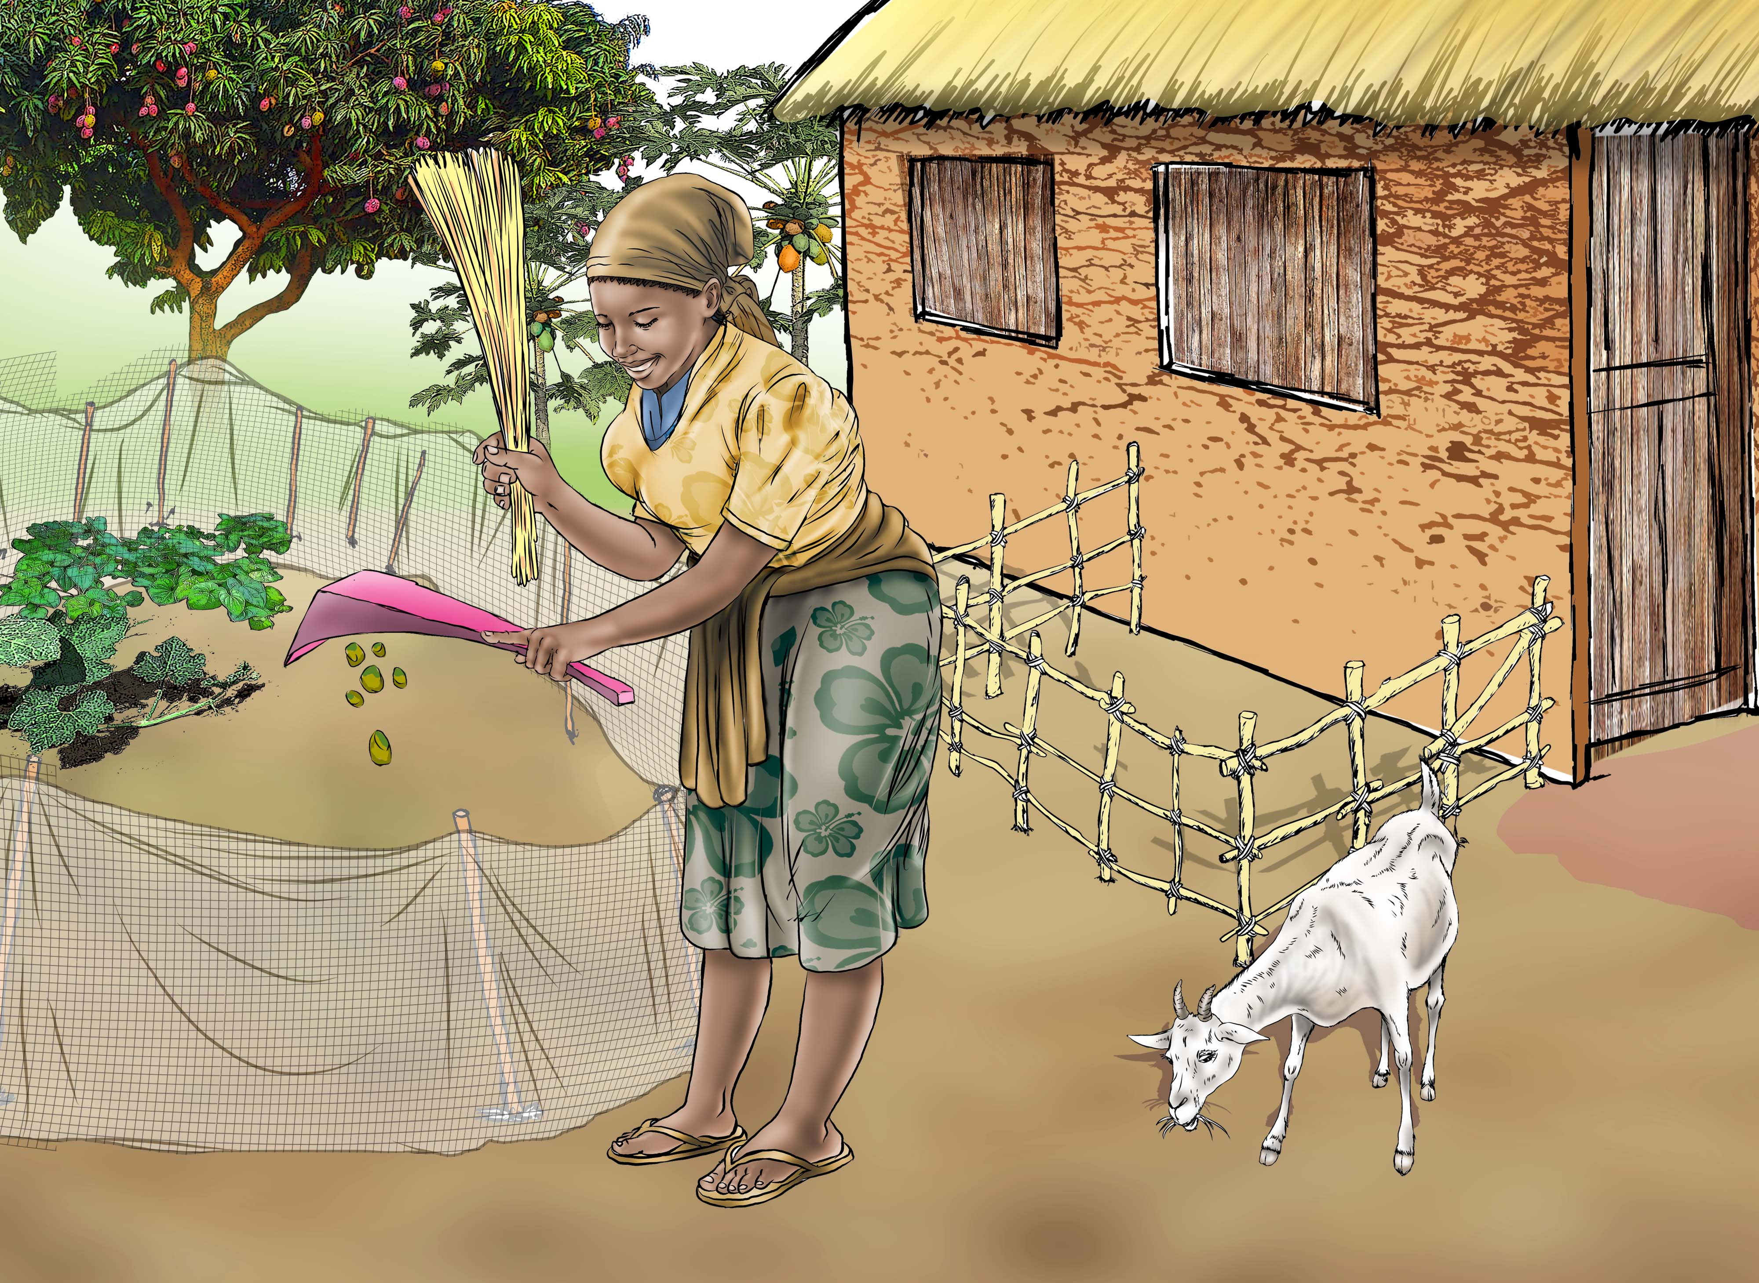
What works to reduce undernutrition? Nutrition-Sensitive Interventions
Food security and quality: Availability & accessibility to diverse, safe, nutritious food
Health services & Water, Sanitation and Hygiene (WASH): Focus on healthy environments
Child & family care: Time, labor, and other resources/practices
These address underlying causes of undernutrition
Image credit: SPRING
Notes:
8

Slide 9
How does agriculture affect nutrition?
Food Produced & Consumed
Calories
Protein
Micronutrients
Safety
Income Generated & How it is Spent
Diverse diet and nutrient-rich foods
Health and WASH services and products
Use of Women’s Time & Energy
Managing demands on women’s time and energy
Maximizing women’s control of income

Slide 10
Five Ways to Improve Nutrition Through Agriculture
Increase Availability & Access to Diverse, Nutritious Foods
1
Encourage Income Use for Better Diets, Health & Hygiene
2
3
Recognize the Central Role of Women in Agriculture and Nutrition
4
Generate Demand for Diverse, Nutritious Foods
5
Establish Policies and Programs to Support a Broad View of Nutrition

Slide 11
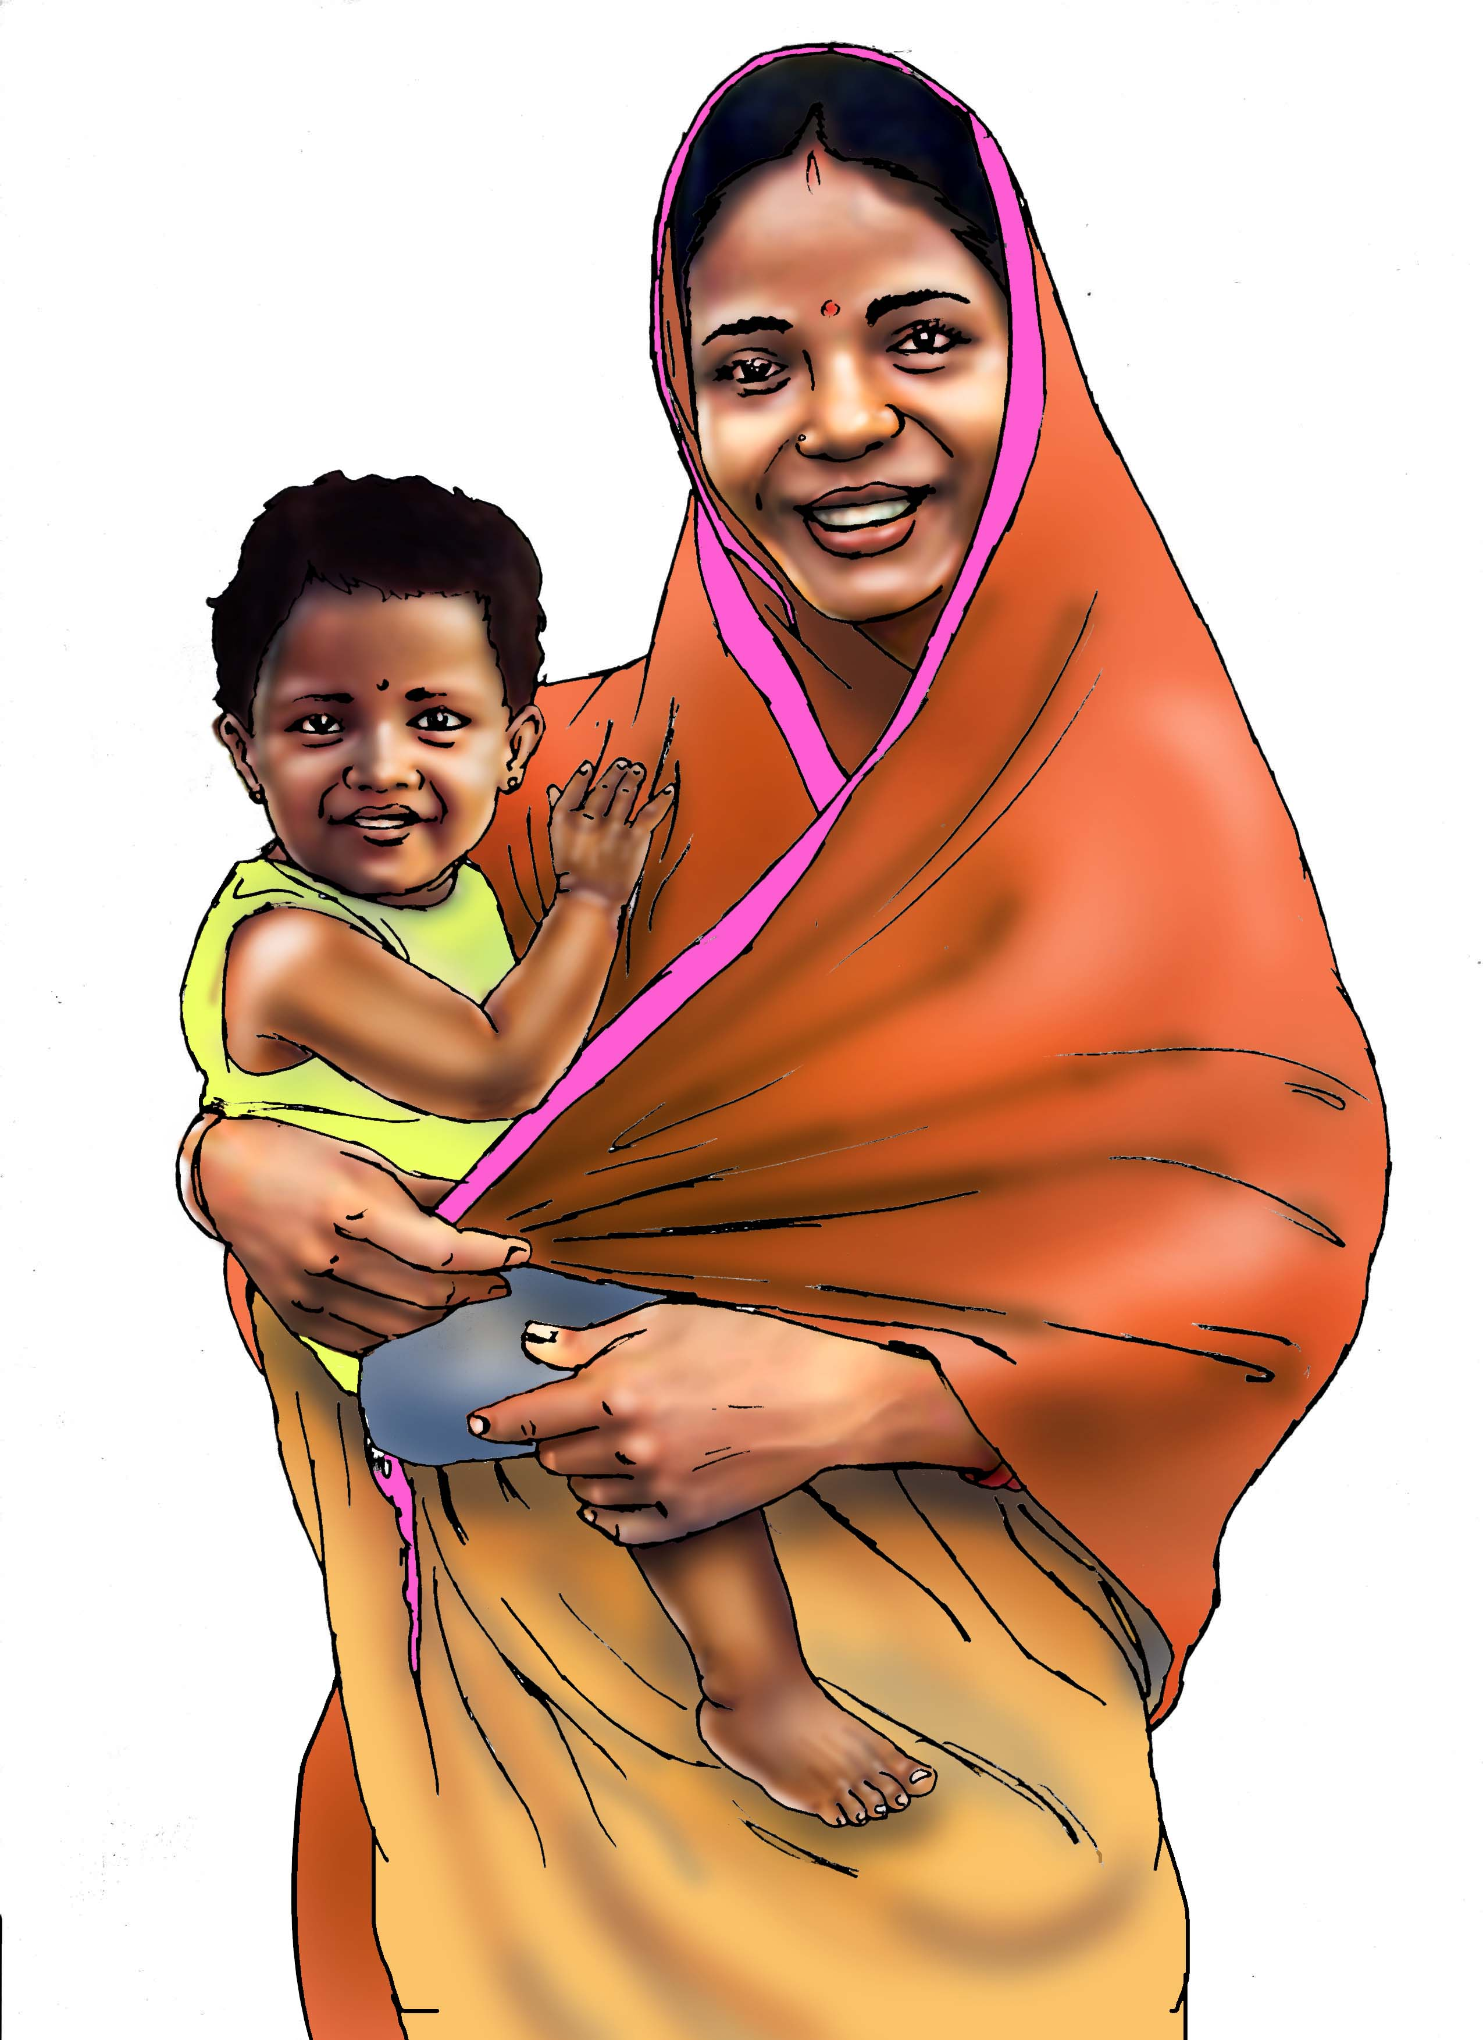
Key Points from This Session
Good nutrition is essential for children to survive and thrive– 45% of child deaths are due to malnutrition.
Nutrition is a sound investment, with a $16 return on every $1 spent.
Nutrition-sensitive approaches address underlying causes of malnutrition: food security & quality, child/family care, health services & WASH.
Agriculture can impact nutrition through food consumed, how income is spent and women’s time, energy and control of income.
Image credit: SPRING

Slide 12
References
Black, Robert E., Cesar G. Victora, Susan P. Walker, Zulfiqar A. Bhutta, Parul Christian, Mercedes de Onis, Majid Ezzati, et al. 2013. “Maternal and Child Undernutrition and Overweight in Low-Income and Middle-Income Countries.” The Lancet 382 (9890):427–51. https://doi.org/10.1016/S0140-6736(13)60937-X.
Hoddinott, J. 2016. “The economics of reducing malnutrition in Sub-Saharan Africa,” Global Nutrition Report (May 13, 2016). Produced for the Global Panel on Agriculture and Food Systems for Nutrition. http://glopan.org/sites/default/files/Global_Panel_Working_Paper.pdf
Horton, Sue, and Richard H. Steckel. 2013. “Global Economic Losses Attributable to Malnutrition 1900–2000 and Projections to 2050.” In The Economics of Human Challenges, B. Lomborg. Cambridge, U.K.: Cambridge University Press.
(IFPRI) International Food Policy Research Institute. 2016. Global Nutrition Report 2016: From Promise to Impact: Ending Malnutrition by 2030. Washington, DC.
Lim, Stephen et al. 2012. “A comparative risk assessment of burden of disease and injury attributable to 67 risk factors and risk factor clusters in 21 regions, 1990–2010: a systematic analysis for the Global Burden of Disease Study 2010” The Lancet 380(9859): 2224–2260. doi:10.1016/S0140-6736(12)61766-8.

Slide 13
Thank you!

