Slide 1
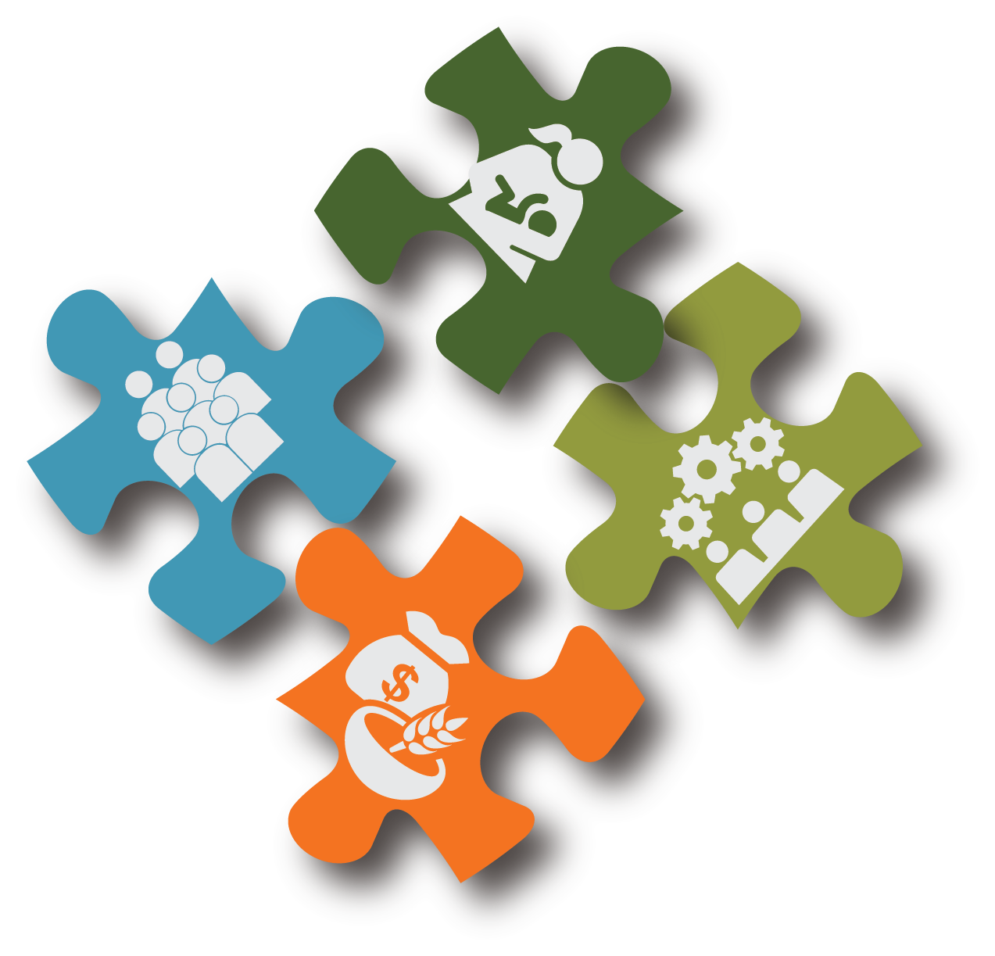
Behavior Change Concepts for Nutrition-Sensitive Agriculture
SPRING Nutrition-Sensitive Agriculture Training Resource Package
February 2018
Notes:
Guidance for how to present these slides is included in the SPRING Nutrition-Sensitive Agriculture Training Resource Package Session Guide: Social and Behavior Change

Slide 2
Objectives
Articulate the basic concepts about why behaviors change
Explain several ways that SBC contributes to improved activity outcomes
Describe how SBC uses formative research to guide activity interventions

Slide 3
What is Social and Behavior Change (SBC)?
Activities that focus on changing the behavior of individuals and communities– including social norms and environmental factors
Encourages people to adopt and maintain practices that contribute to specific outcomes
However, in order to change how people behave, we need to first understand their current behavior– SBC activities strive to do both

Slide 4
Clearly Defining Behaviors: “Behavior” and “Practice”
We use the words “behavior” and “practice” interchangeably, to mean a concrete action that a specific person or group does at a specific time and place.
Behaviors have characteristics including:
whether they are observable or hidden(private)
their specificity (time, place, quantity, duration, and/or frequency)
whether they are easy or hard to measure, and
whether they are feasible to adopt and maintain over time.
Photo credit: Knowledge-based Integrated Sustainable Agriculture and Nutrition (KISAN) Project
Notes:
Adapted from: The Technical and Operational Performance Support (TOPS) Program. 2017. Designing for Behavior Change: A Practical Field Guide. Washington, D.C.: The Technical and Operational Performance Support Program. http://www.fsnnetwork.org/sites/default/files/designing_for_behavior_change_a_practical_field_guide.pdf

Slide 5
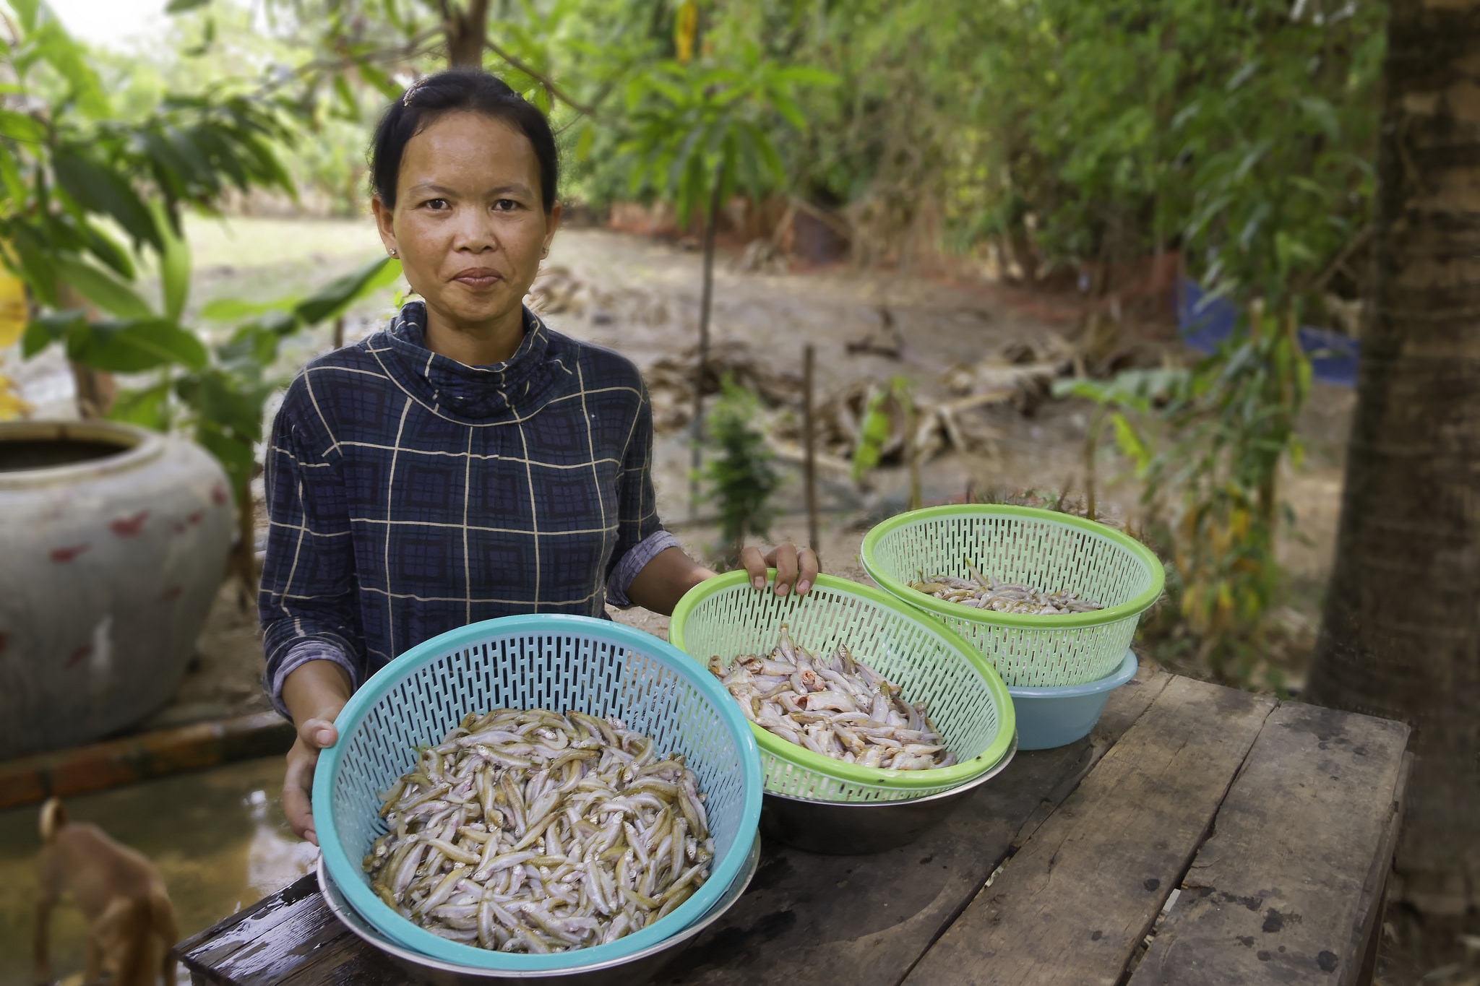
Clearly Defining Behaviors: Behavior Statements
A behavior statement helps to define a priority behavior clearly so that project staff can understand what change we are striving for and know how to plan for and monitor the change.
Behavior Statement:
Priority Group + Action verb in present tense + The details
Example behavior statement: Targeted care givers add Small Fish Powder to the meals for their children under five years of age each day.
Photo credit: Igor Dashevskiy, the NOURISH Project
Notes:
Adapted from: The Technical and Operational Performance Support (TOPS) Program. 2017. Designing for Behavior Change: A Practical Field Guide. Washington, D.C.: The Technical and Operational Performance Support Program. http://www.fsnnetwork.org/sites/default/files/designing_for_behavior_change_a_practical_field_guide.pdf

Slide 6
5 Behave Principles
Base decisions on evidence and keep checking in.
Understand exactly who your priority groups are, work closely with them to understand everything from their point of view.
Bottom line: Action is what counts (not knowledge, attitudes, or beliefs).
People take action when it benefits them. Barriers keep them from acting.
All SBC activities should maximize the benefits and minimize the barriers that matter to the people with whom you are working.
Notes:
Adapted from: The Technical and Operational Performance Support (TOPS) Program. 2017. Designing for Behavior Change: A Practical Field Guide. Washington, D.C.: The Technical and Operational Performance Support Program. http://www.fsnnetwork.org/sites/default/files/designing_for_behavior_change_a_practical_field_guide.pdf

Slide 7
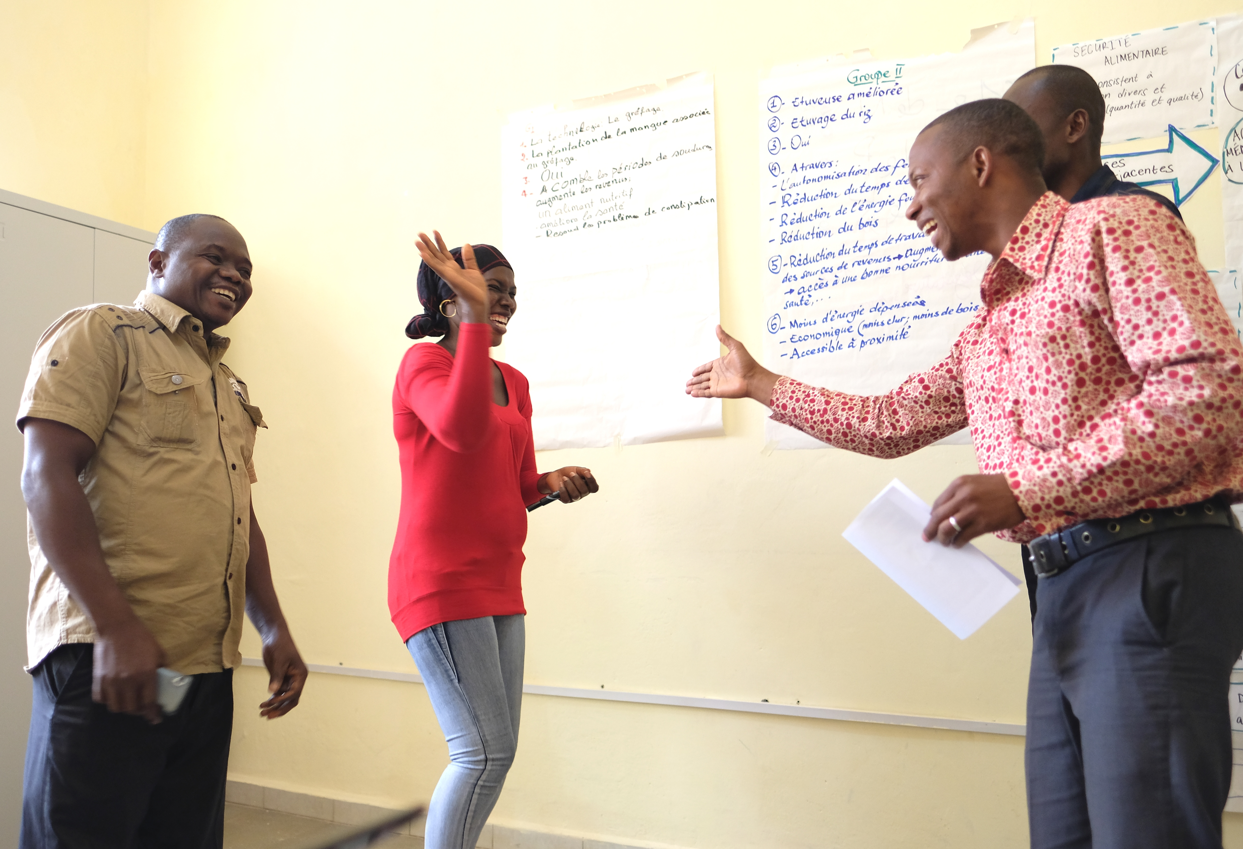
Using SBC approaches in design helps us identify which activity interventions will have the most impact in a specific context, with specific people
Photo credit: Sarah Hogan, SPRING

Slide 8
SBC in Practice
SBC is at work in nearly every person’s life– both personally and professionally.
What behaviors does your activity aim to change?

Slide 9
Exercise: The “exercise” exercise

Slide 10
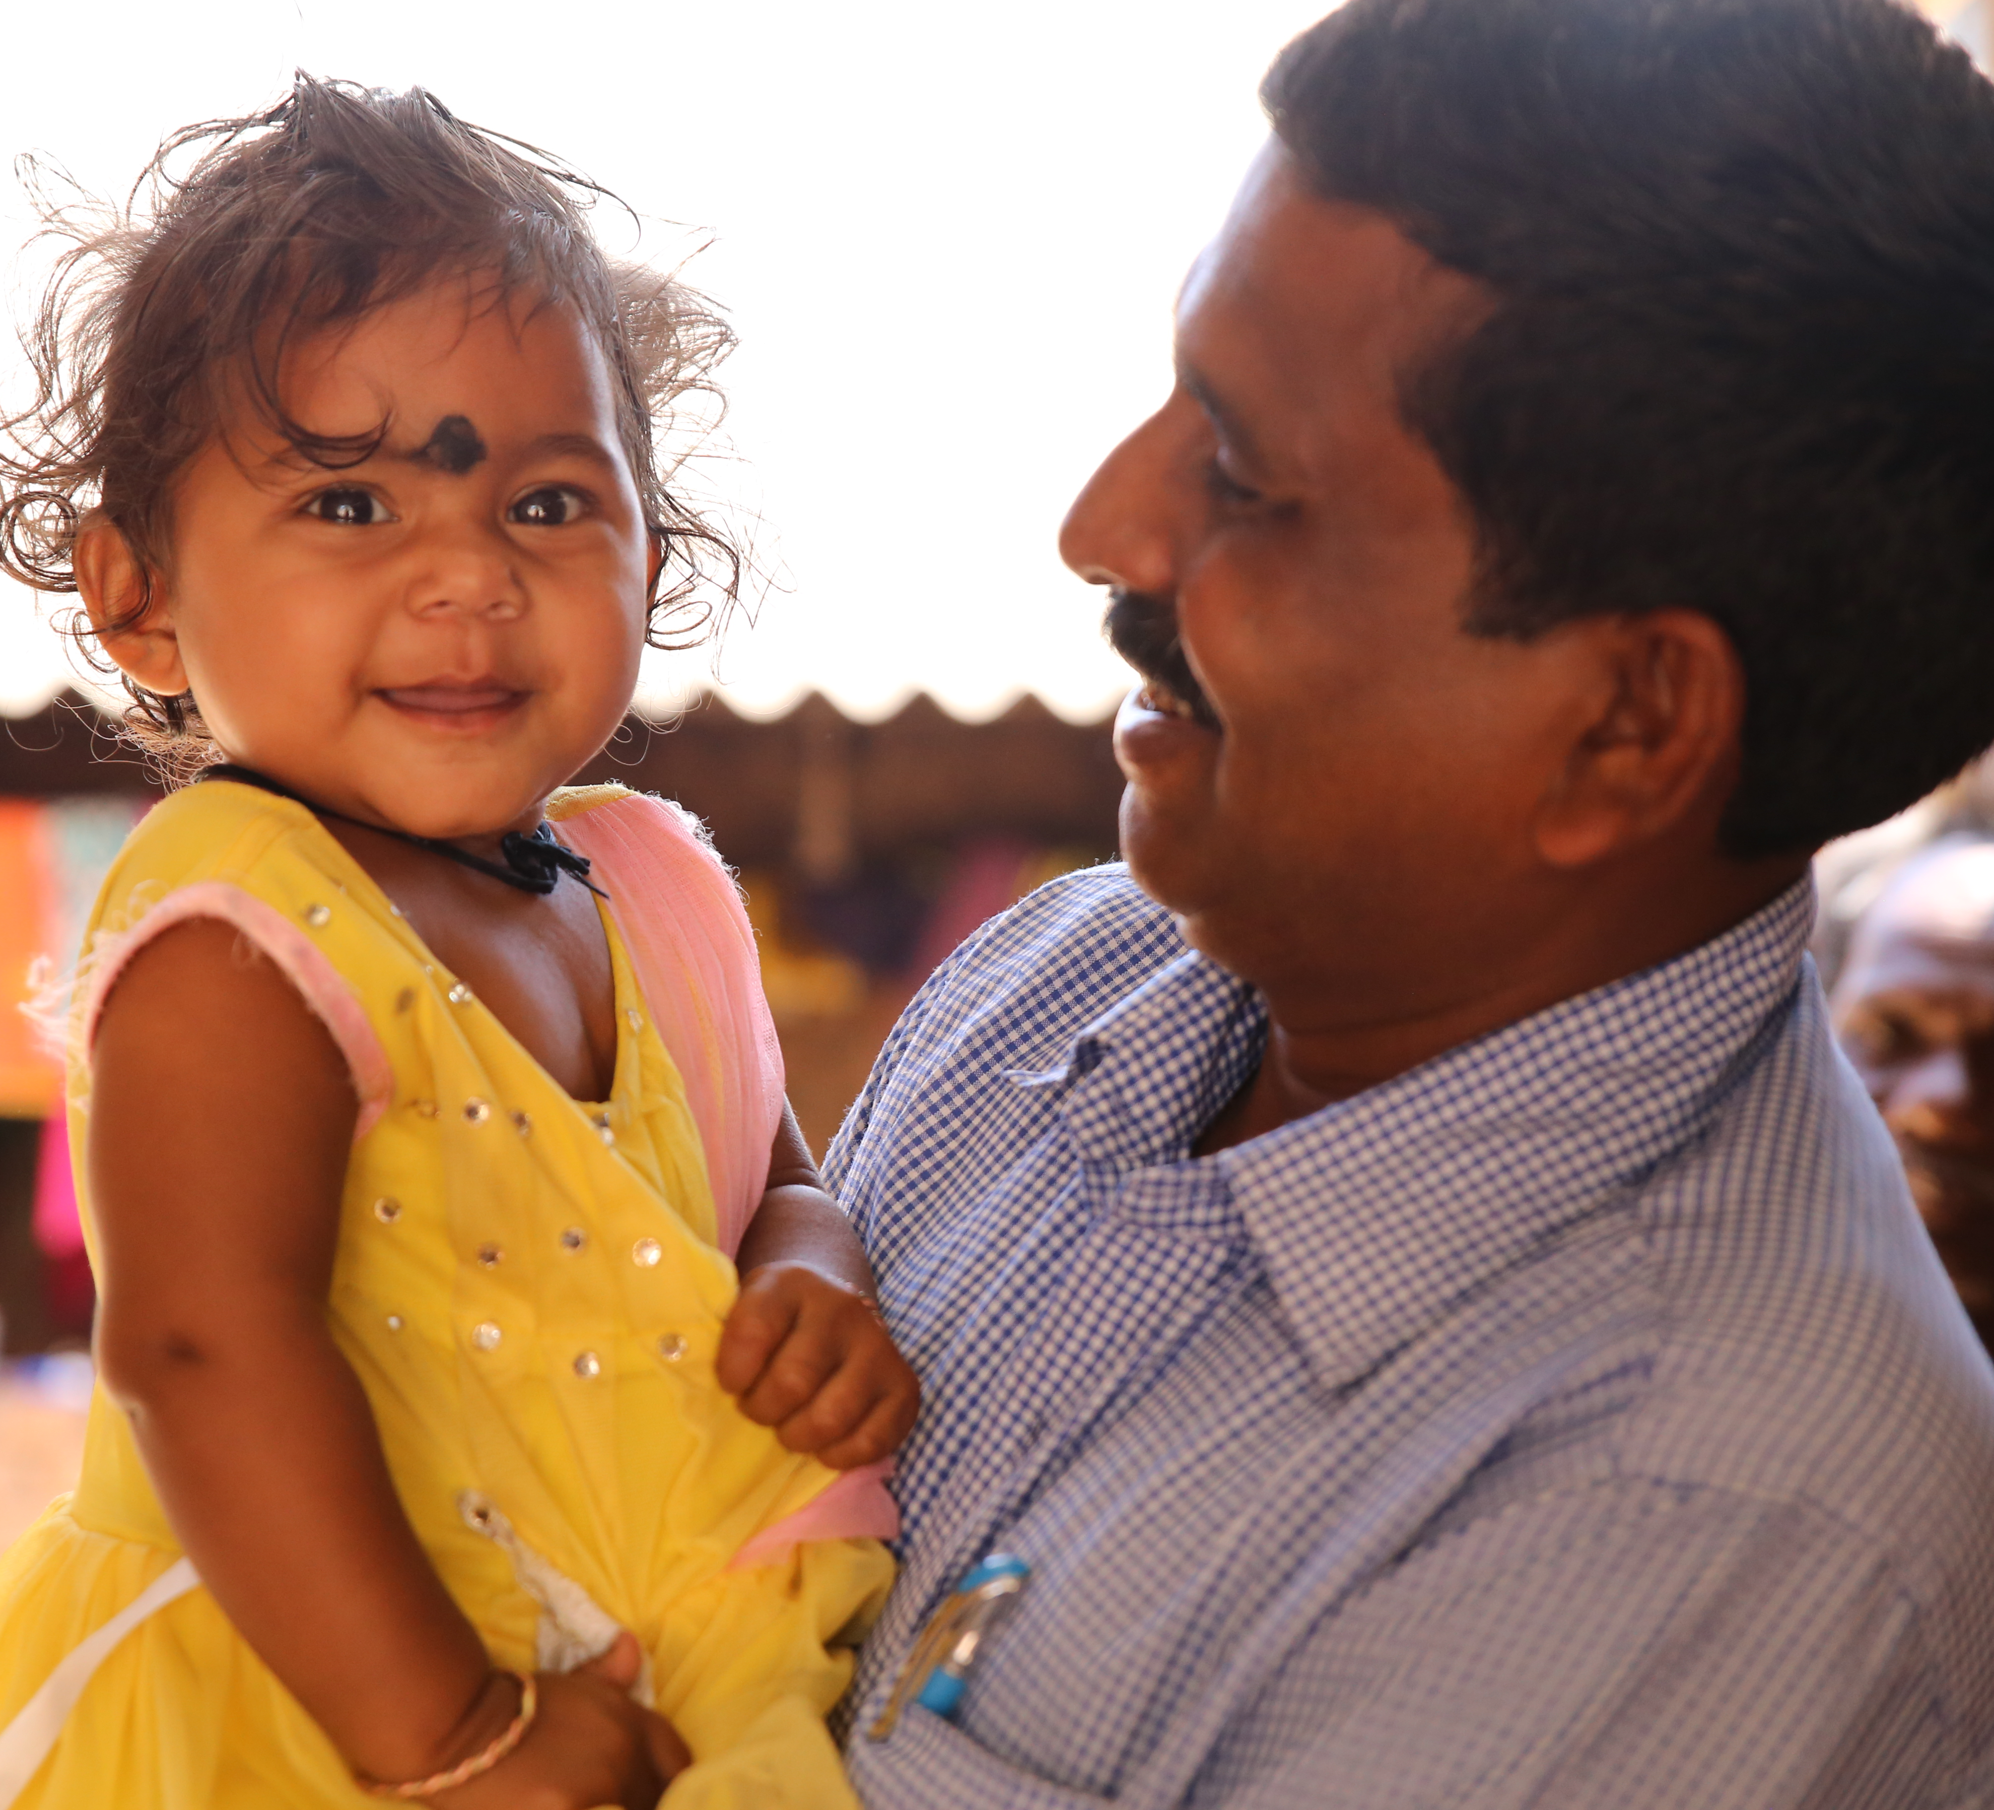
Effective SBC Interventions Facilitate Change
How people think & feel about an issue
Physical & market environments
Levels of participation in certain activities
Policies that create incentives/disincentives
Resources available
Social norms, identities and roles
Photo credit: Peggy Koniz-Booher, SPRING

Slide 11
Change Agents and Communities May Think About a Problem Differently
“People don’t live their lives in sectors: health or education or infrastructure... People live in families and villages and communities, where the issues of everyday life merge. We need to connect the dots.”
— Robert Zoellick, former head of World Bank (2010)
Photo credit: Tim Williams, SPRING

Slide 12
Increasing Activity Impact Through SBC
Activities that use SBC approaches have a greater impact than those that do not.
Reaching target groups through multiple channels and points of contact improves effectiveness of SBC interventions.
A wide variety of delivery strategies have evidence of effectiveness, with 1-on-1 and small group communication having the most evidence.*
Photo credit: Fintrac Inc.
*SPRING SBCC literature review: https://www.spring-nutrition.org/publications/series/evidence-effective-approaches-social-and-behavior-change-communication

Slide 13
Promoting Behavior Change Effectively
Promote practices in local terms
Link improved practices to short term risks and benefits
Messages should grab the heart and gut as well as the mind
Social identities and gender roles can enable or constrain acting on messages
Messages need to be appropriately targeted
Photo credit: Sarah Hogan, SPRING, India

Slide 14
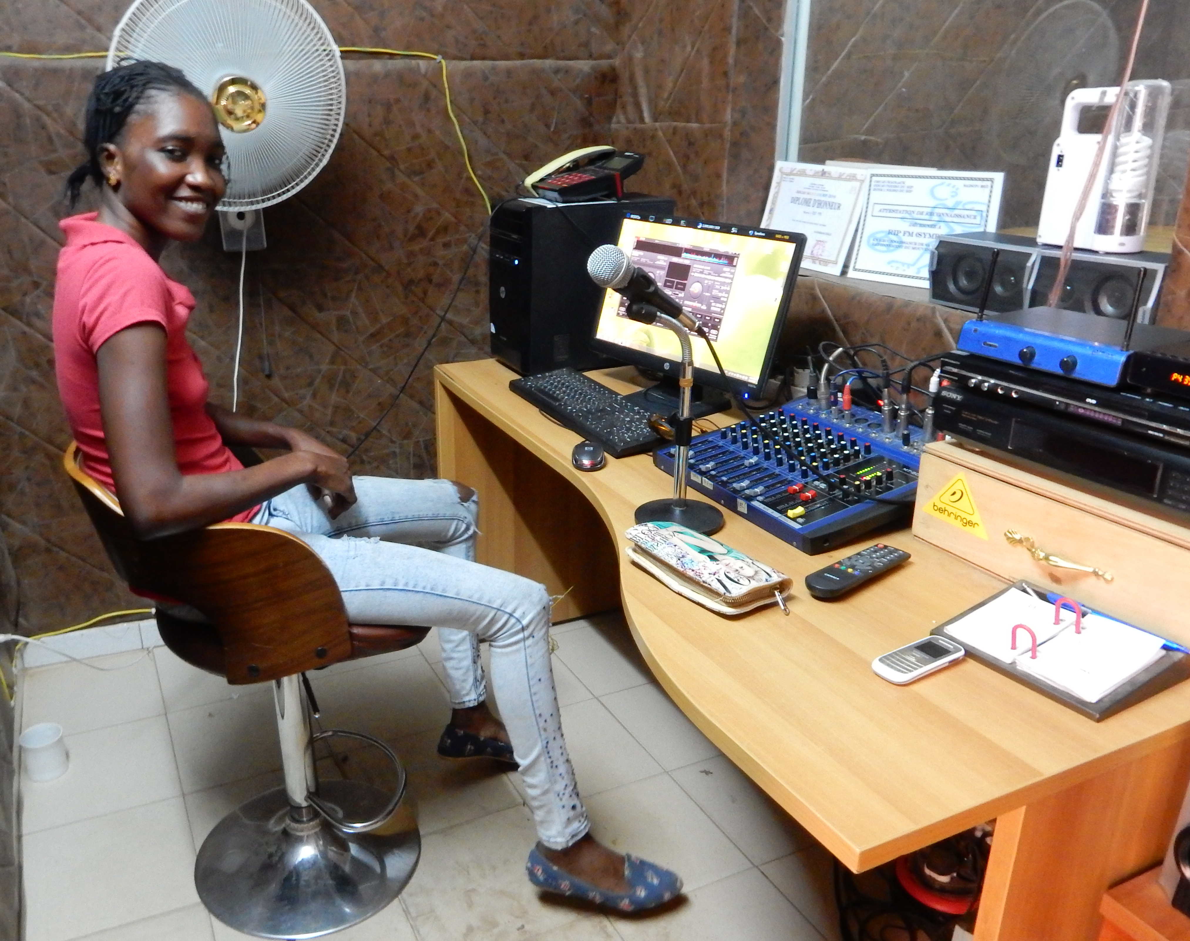
Social, Market, Policy, and Physical Environments are Essential for Change
People are more likely to change when there is a change in their society.
Changes can be encouraged through mass media, market-led interventions and advocacy.
Photo credit: Peggy Koniz-Booher, SPRING

Slide 15
Key Concepts and Models for SBC

Slide 16
The COM-B Model: Getting to Action
Capability
Motivation
Behavior
Opportunity
Adapted from Michie, van Stralen, and West, 2011

Slide 17
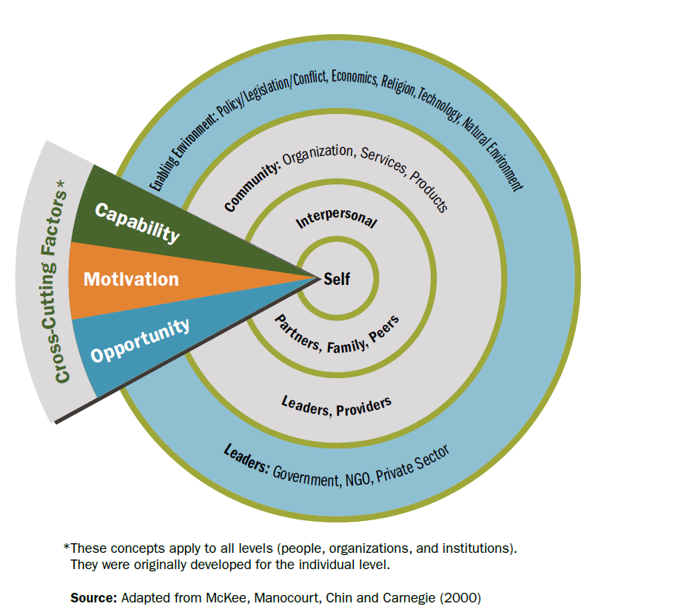
The Socio-Ecological Model

Slide 18
What is formative research?
Data collection to inform activity design, helping uncover priority practices and factors for effective program interventions
Can be done at any time during an activity’s lifecycle
Focuses on understanding small, practical actions that fit within existing environments
Helps us understand how to promote practices effectively

Slide 19
Formative research in Odisha, India
Household and community environment, markets, resources, and services
Community priorities related to agriculture, livelihoods, and nutrition
WASH practices, attitudes, and beliefs
Gender roles, household relationships, and decision-making
Gender roles, division of labor and labor sharing
Attitudes and beliefs related to commonly produced and/or purchased foods
Farming practices, attitudes, and beliefs
Seasonal challenges related to food security, income and expenditure, labor demands, and health issues

Slide 20
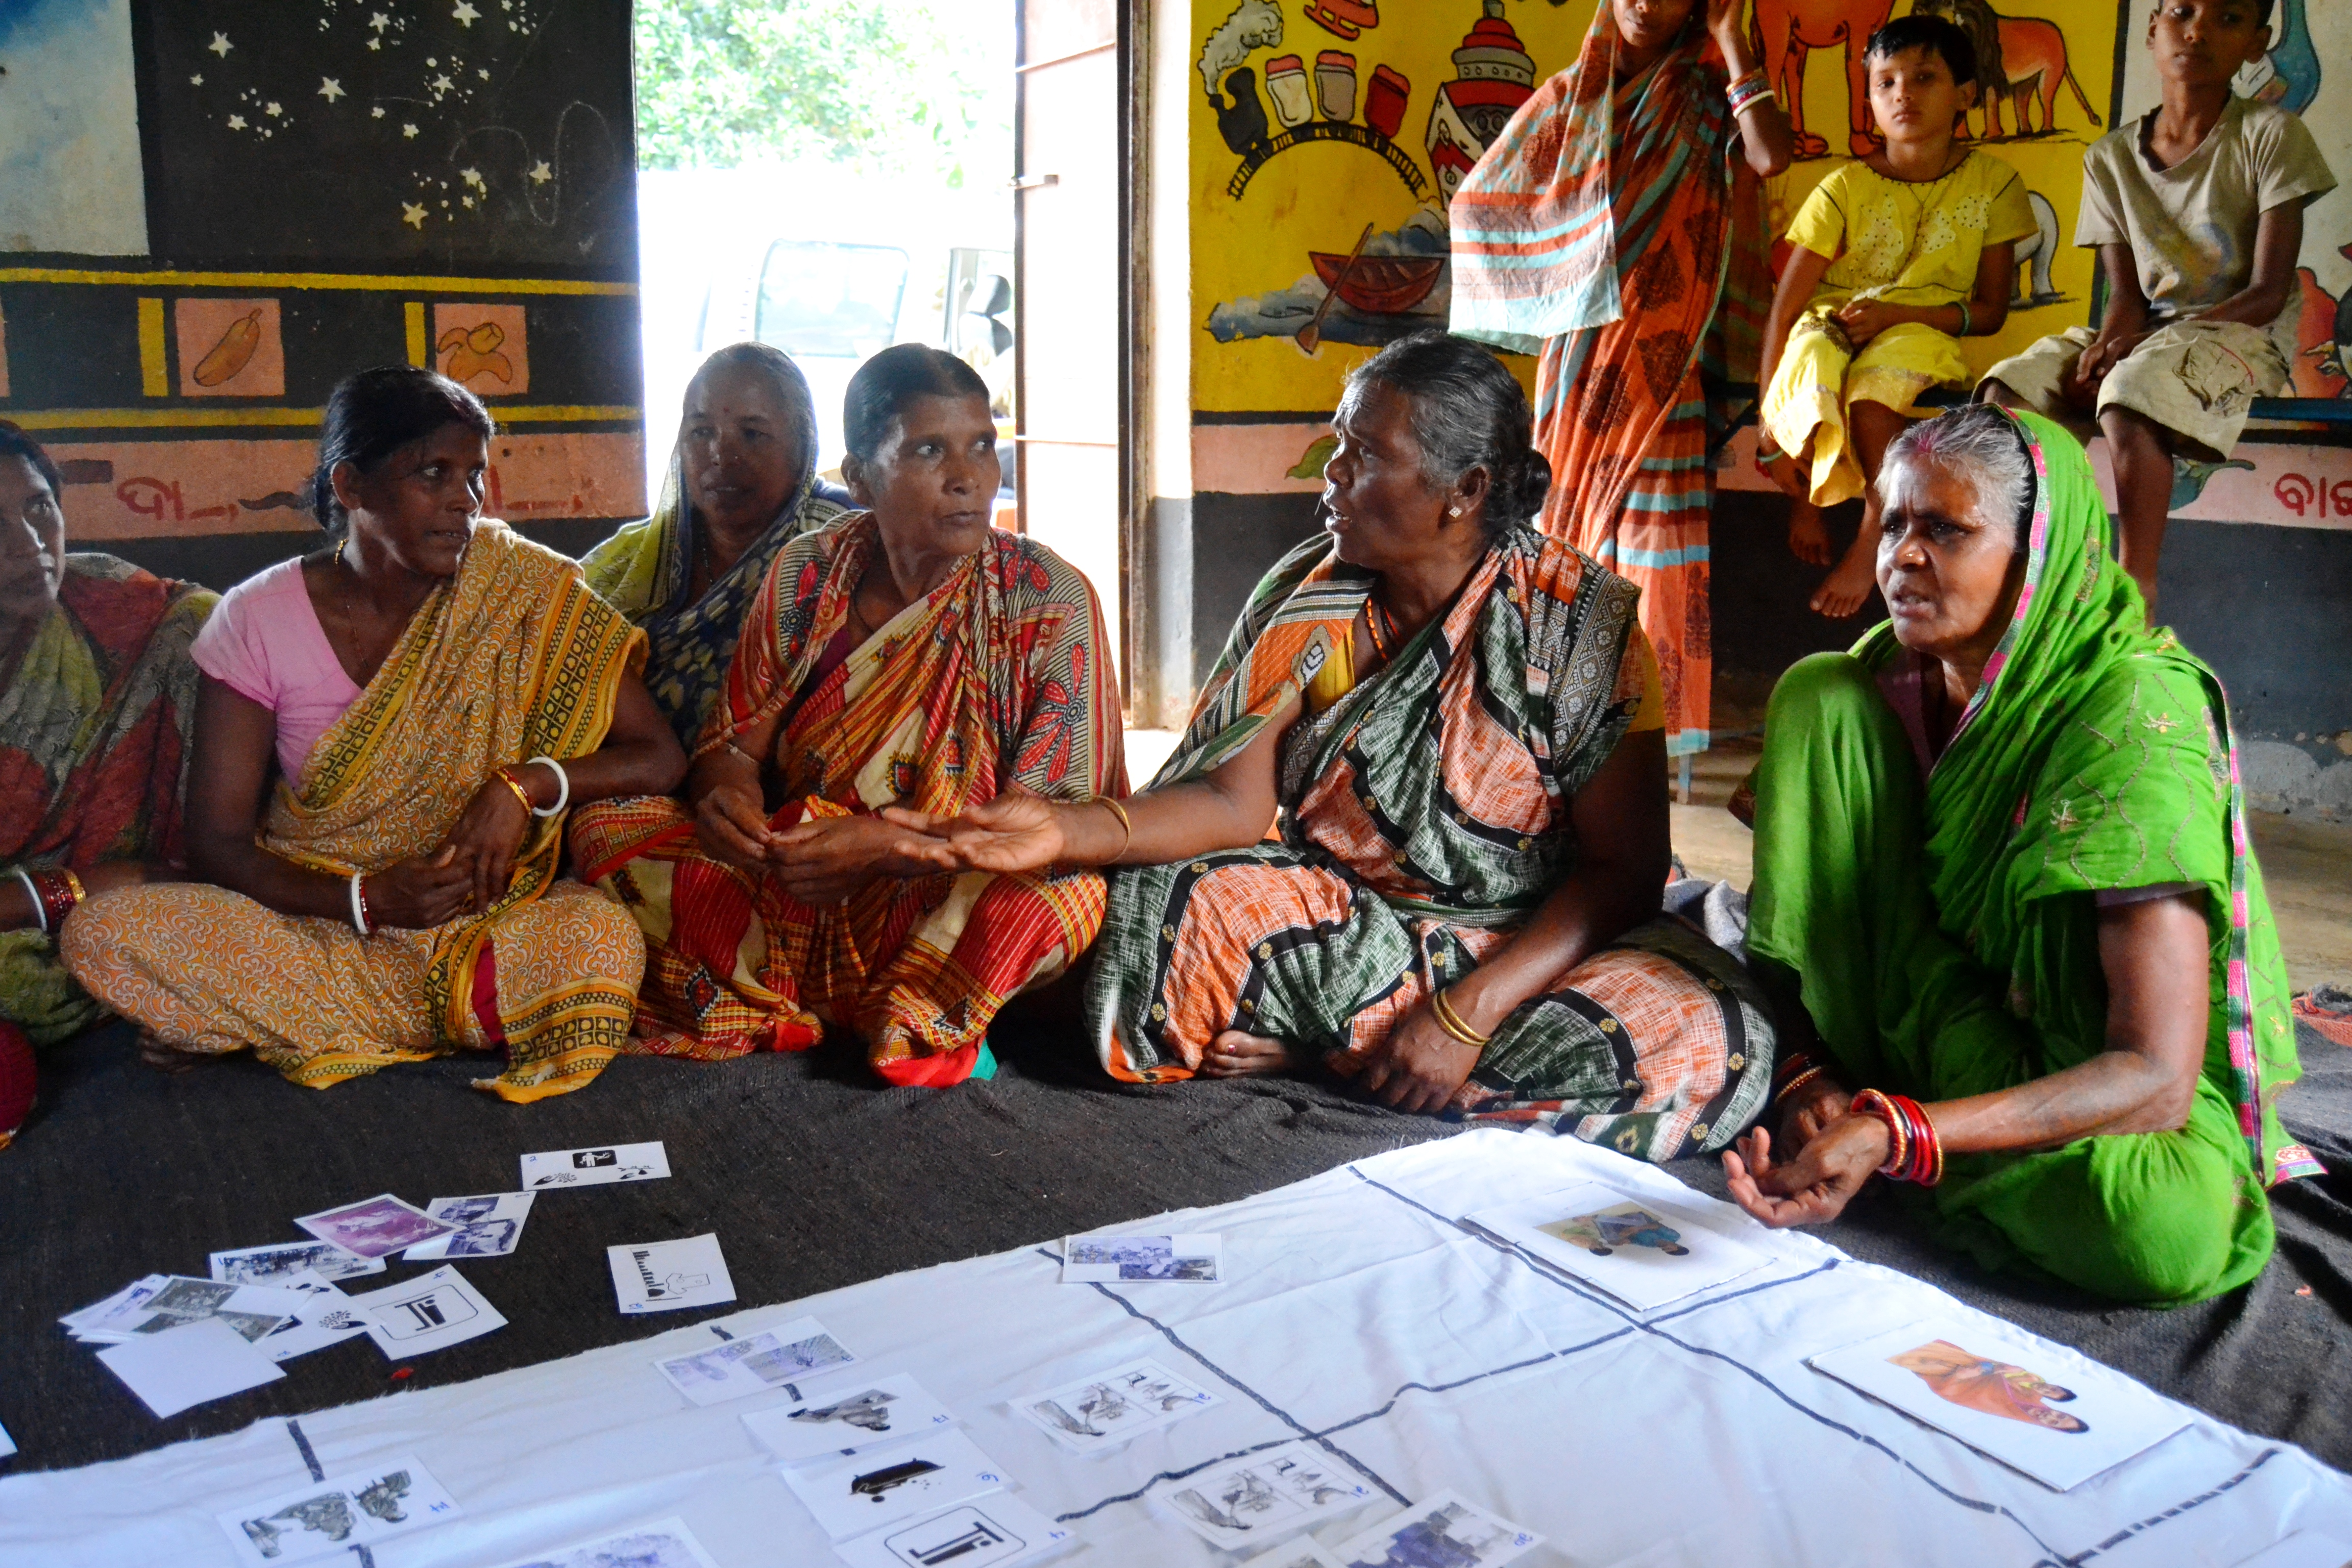
Data collection methods used for formative research in Odisha, India
Open-ended discussion
Food ranking
Daily activity chart
Seasonal calendar
Transect walk
Photo credit: Sarah Cunningham, SPRING

Slide 21
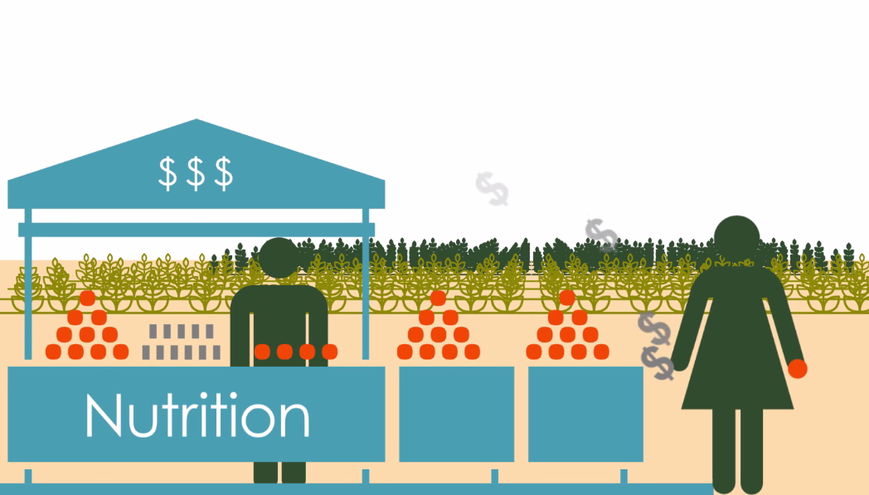
Strengthen Enablers for Change
Increase demand for nutritious foods AND
Ensure nutritious foods are available in local markets AND
Ensure farmers can grow them (accessible supplies & equipment)
Increasing demand and supply together is complicated, but critical

Slide 22
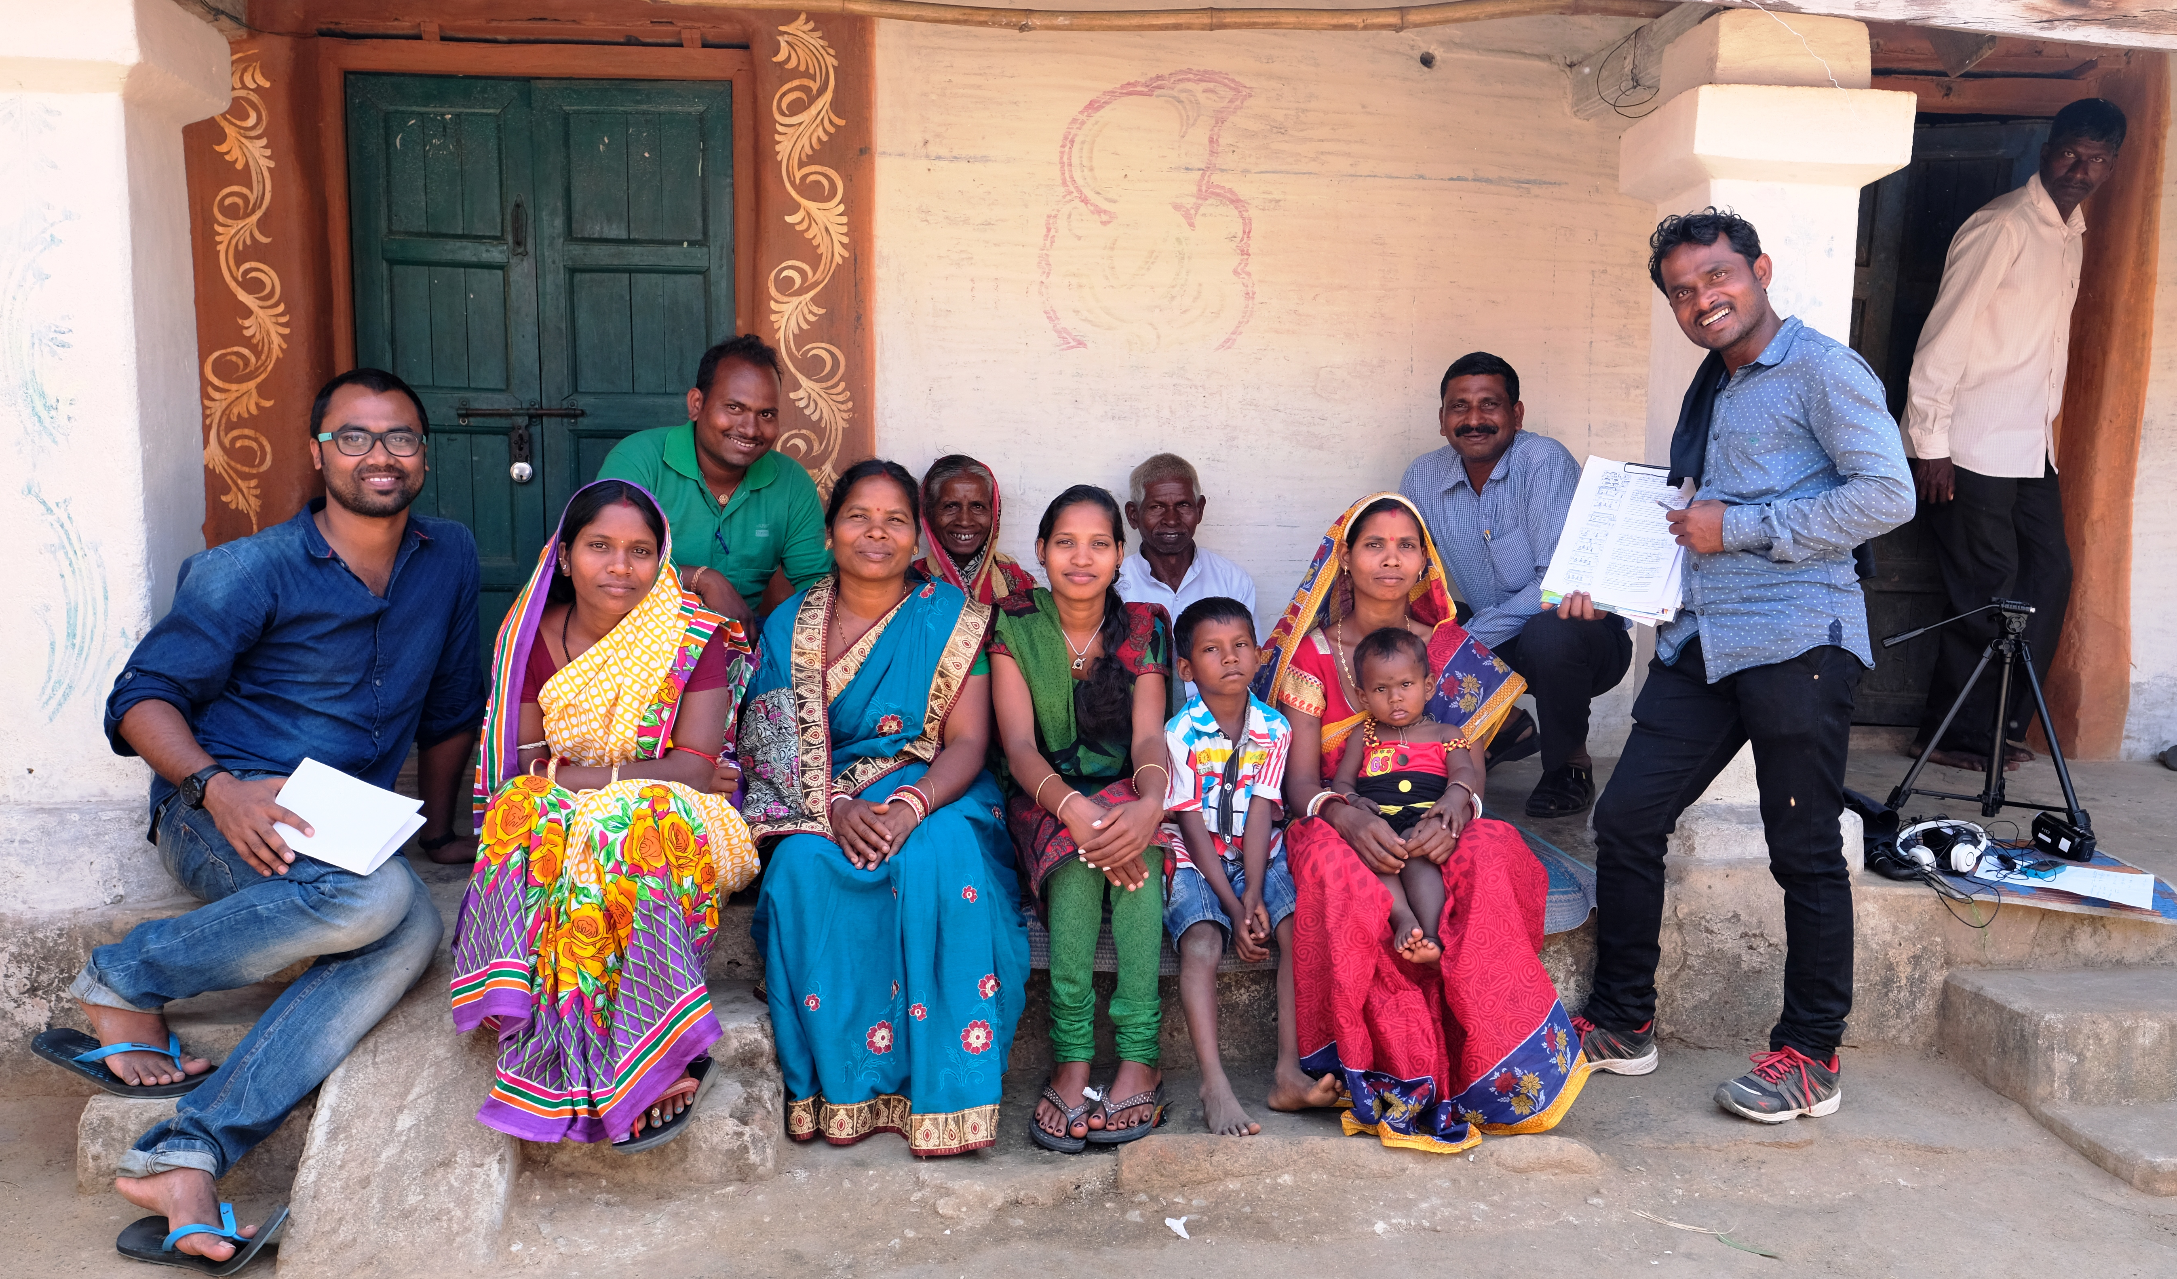
Applying SBC to Design: Joint Decision-Making
Community-produced videos show a local family:
Discussing risks and benefits together;
Sharing tasks to improve practices; and
Deciding together when to consume meat/eggs at home, when to sell meat/eggs, and how to use income.
Photo credit: Sarah Hogan, SPRING

Slide 23
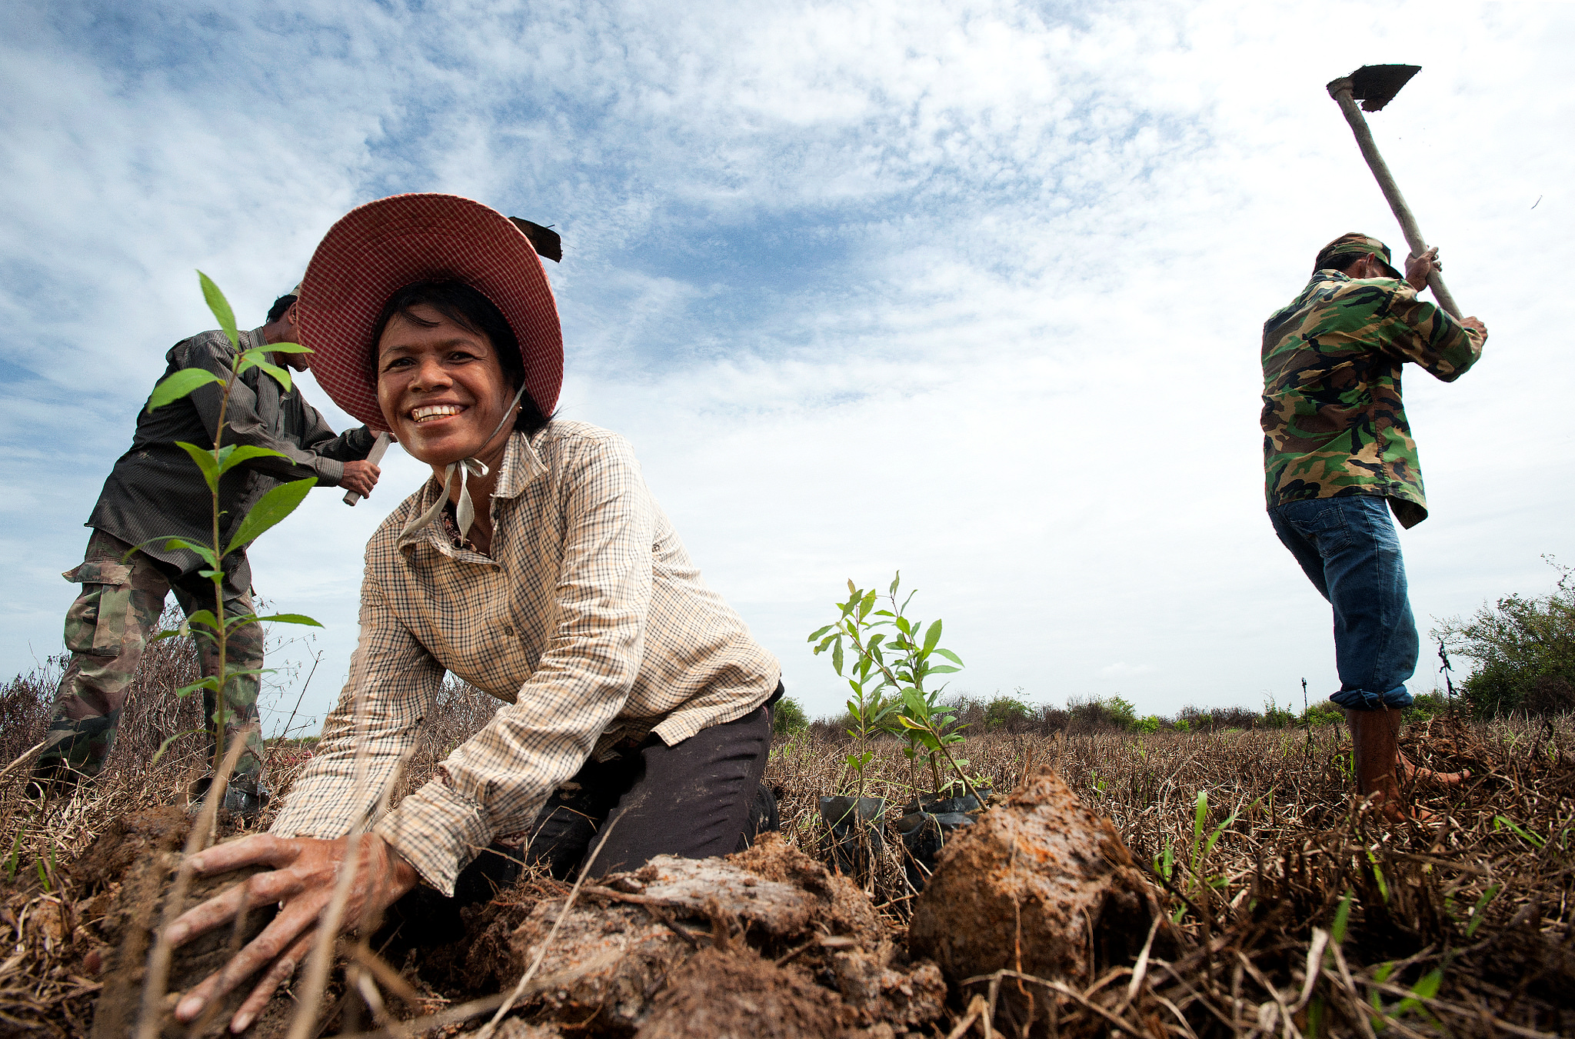
Accelerating Behavior Change in Nutrition-Sensitive Agriculture: On-line Course
Photo credit: Cambodia, HARVEST

Slide 24
Key Points from This Session
Social and behavior change encourages people to adopt and maintain practices that contribute to specific outcomes
Activities that use SBC approaches are better able to achieve stated outcomes, as compared with those that have no SBC component
SBC for nutrition-sensitive agriculture focuses on:
Which agriculture practices can best contribute to nutrition outcomes in a given context?
How can we improve uptake of specific practices?

Slide 25
Thank you!
For more information, please contact:

