Slide 1
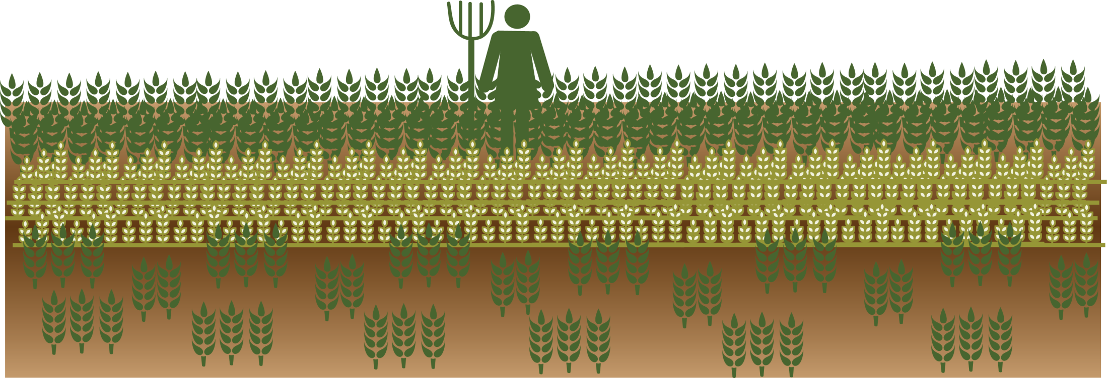
Essential Concepts in Agriculture and Food Systems
SPRING Nutrition-Sensitive Agriculture Training Resource Package
February 2018

Slide 2
Agriculture Elements of the Pathways
Food Produced & Consumed
Calories
Protein
Micronutrients
Safety
Income Generated & How it is Spent
Diverse diet and nutrient-rich foods
Health and WASH services and products
Use of Women’s Time & Energy
Managing demands on women’s time and energy
Maximizing women’s control of income

Slide 3
Objectives
Explain the importance of agriculture in food production, income generation and women’s lives.
Articulate the overarching goals of most agriculture programs.
Explain the relationship between agricultural value chains and food systems.
Identify challenges and opportunities for agriculture programs today.

Slide 4
Understanding Agriculture
Agriculture is the science and practice of farming
Cultivation of the soil for crops and raising animals to provide food, wool, and other products
Impacts the world’s population:
Producing food
Source of income
How many people spend their time and energy (especially women)

Slide 5
Enough Food Is Produced to Feed Everyone
Worldwide, food production is high enough to feed the world’s population
Yet, hunger continues– many people cannot access or afford food
About 1/3 of all food produced is lost in the food supply chain.
Recovering just half could feed the world.
Source: CGIAR Research Program on Climate Change, Agriculture and Food Security (CCAFS).

Slide 6
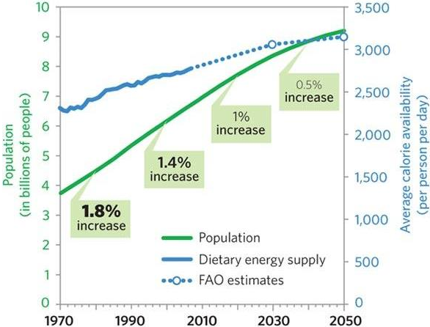
Agriculture and Food Production
Today: 815 million hungry people
2050: In developing countries, production must double
Source: “Food: The Growing Problem”.

Slide 7
Agriculture as a Source of Income
Source: FAO Statistical Yearbook 2013. Food and Agriculture Organization of the United Nations, Rome 2013 http://www.fao.org/economic/ess/ess-publications/ess-yearbook/en/
FAO Statistical Pocket Book. 2015 http://www.fao.org/economic/ess/ess-publications/ess-yearbook/en/
How many people are involved in agriculture?
Globally: 1 in 3 workers
In sub-Saharan Africa: 60% of the workforce
Typically, this is self-employment or unpaid family work– many are subsistence farmers
Investments in agriculture help reduce poverty
GDP growth generated by agriculture is 4X more effective at reducing poverty than growth generated by other sectors
Source: FAO 2013; FAO 2015.

Slide 8
But, farming is not easy...
And, at the same time…
keep one eye on unpredictable weather; and,
keep the other eye on changing markets.
You have to know:
when to sow,
how to grow,
when to harvest
how to sell.
…This knowledge contributes to deciding WHAT to grow.
These production choices affect the whole system of agricultural activities.

Slide 9
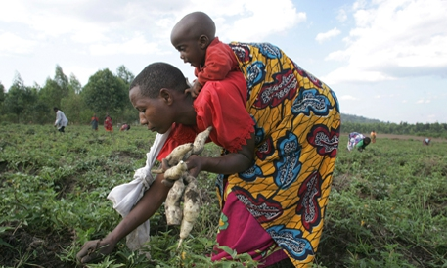
Agriculture and Women’s Lives
Women are more active in agriculture than men–especially unpaid labor.
This impacts the health of the whole family
Pregnant/breastfeeding women perform agricultural labor– making it even harder to meet nutritional needs
She has less time to care for other children
Little control over agricultural income
Photo credit: Giulio Napolitano, FAO
Source: FAO 2013

Slide 10
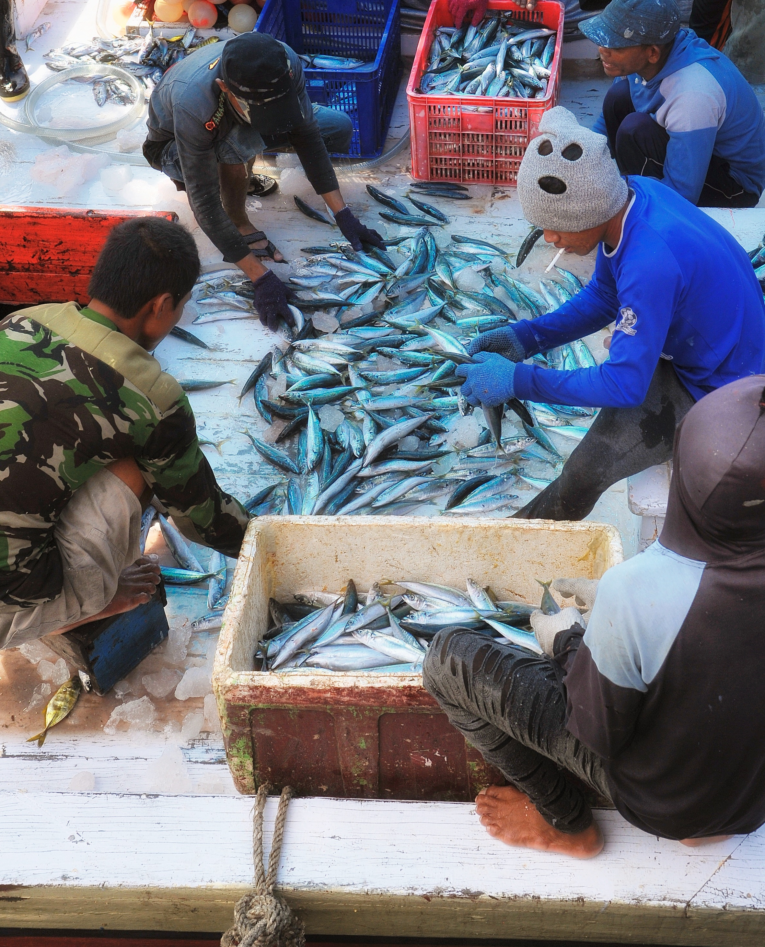
The Goals of Agriculture Programs
Improving production to increase productivity can lead to an increased availability of foods for smallholder farmers
Strengthening markets to increase income can lead to increased access to food for smallholder farmers
Photo credit: Mark Walter, Nathan Associates Inc.

Slide 11
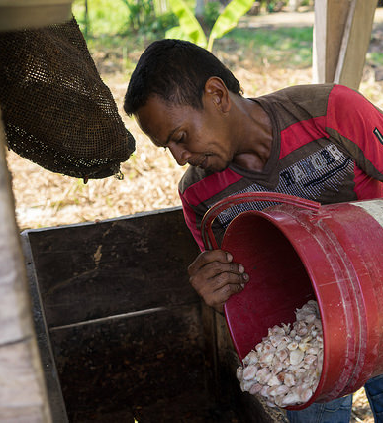
Agriculture Programs Work on Multiple Levels
Both on the farm and among systems that affect supply and demand
Production, processing, marketing, distribution, utilization, and trade
Whole systems around growing food, buying food and consuming food
Photo credit: Thomas Cristofoletti, USAID
Source: USAID 2004.

Slide 12
Exercise: Mapping a food system

Slide 13
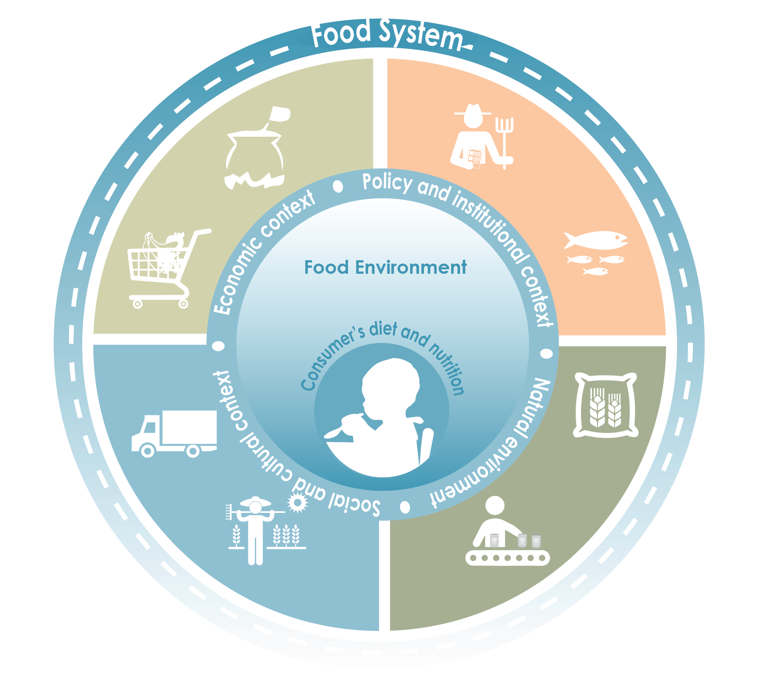
Food System
Consumer demand,
food preparation and preferences
Food production
Food trade and marketing
Food handling, storage, and processing
Adapted from FAO Improving Nutrition through Agriculture and Food Systems E-learning Course

Slide 14
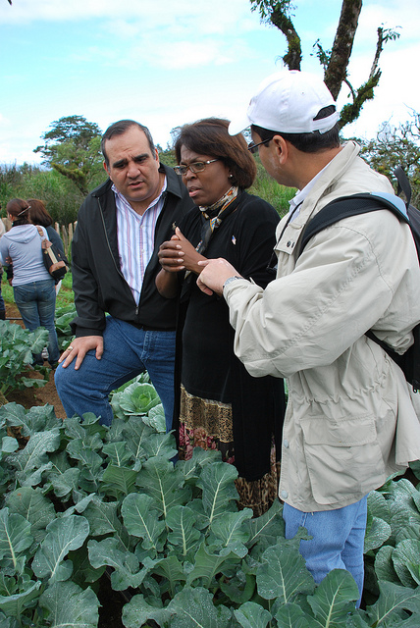
Actors in the Food System
Activities in a food system are driven by the behavior of a set of actors, such as:
Consumers
Buyers
Traders
Processors
Farmers
Food Preparers
Chefs
Government
Researchers
Suppliers
Bankers
Extension agents
Photo credit: Michelle Los Banos-Jardina, USUN Rome

Slide 15
Value Chains– Product Specific
Inputs
Production (incl. farmers & laborers)
Storage & Processing
Enabling Environment
Transport & Distribution
Enabling Environment
Service Provision
Service Provision
Trading/Marketing
Promotion & Sales
Preparation & Consumption

Slide 16
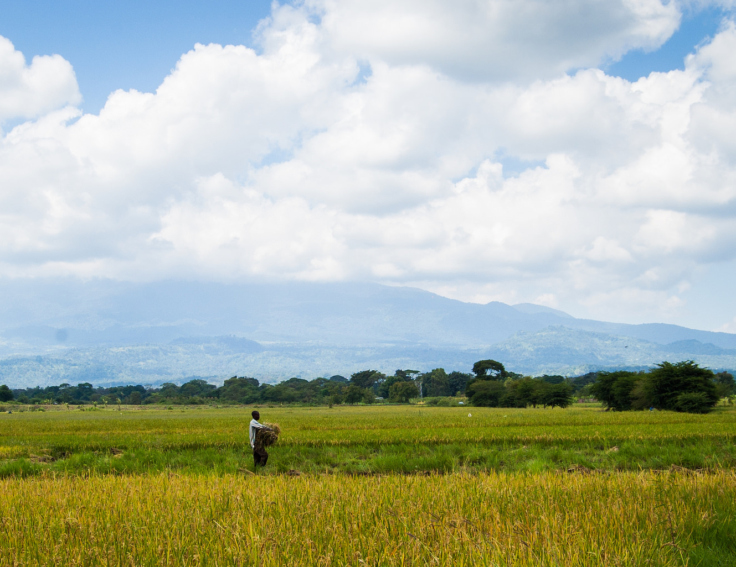
How do we continue to increase production and income, without negatively impacting the environment?
Photo credit: Megan Johnson, USAID

Slide 17
Challenge 1: Limited Natural Resources
Land Use (2012)
Source: FAO 2015.

Slide 18
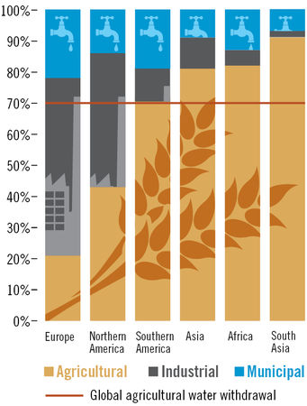
Challenge 1: Limited Natural Resources Water Use (2014)
Source: Foundation on Future Farming.

Slide 19
Challenge 1: Limited Natural Resources Climate Change
Responsible for 20% of greenhouse gas emissions.
As cropping systems are affected by changes in weather, many will shift toward livestock
Source: CGIAR Research Program on Climate Change, Agriculture and Food Security (CCAFS).

Slide 20
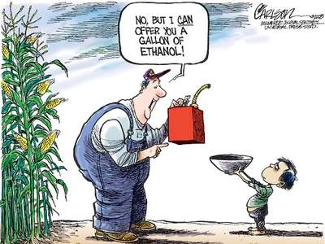
Challenge 2: Shifts in What is Grown & Eaten
Cereal production has steadily increased since the year 2000.
However, this has not done much to reduce food insecurity.

Slide 21
Animal source foods: Grams per capita daily 1990 - 2011
Challenge 2: Shifts in What is Grown & Eaten

Slide 22
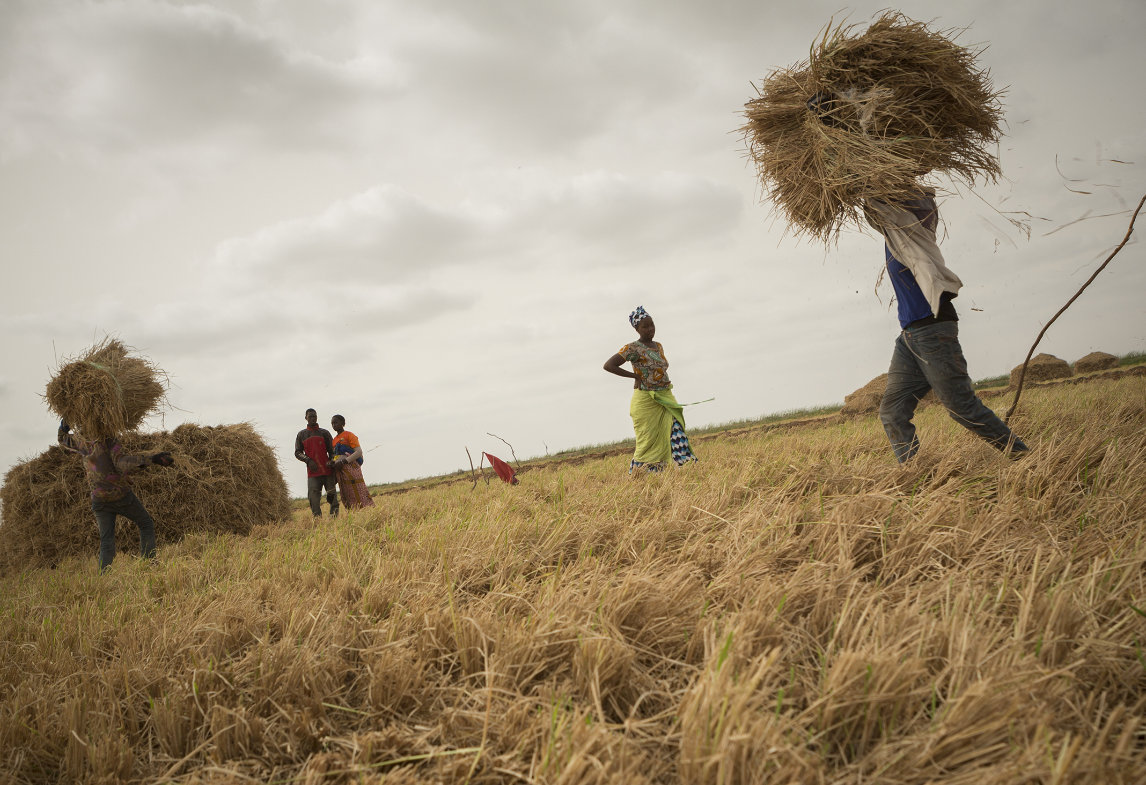
A Smarter Approach to Agriculture
Photo credit: Jake Lyell, MCC

Slide 23
Solutions: Create Shifts in Consumer Demand
Consumer demand is the strongest driver of what is produced
Education about the importance of a nutritionally rich, diverse diet, especially for women and children
Improved packaging and marketing to help consumers recognize quality foods
Recognize the specific challenges of urban populations, addressing the availability of cheap, processed food

Slide 24
Solutions: Supportive Government Policies
Government policies can have an impact on availability and access to healthier foods
Promote production and supply of nutrient-rich foods
Affect prices for consumers– lower costs build demand
Reducing trade barriers or provide incentives for increasing the diversity of foods available in markets
Mandate positive actions– such as micronutrient fortification

Slide 25
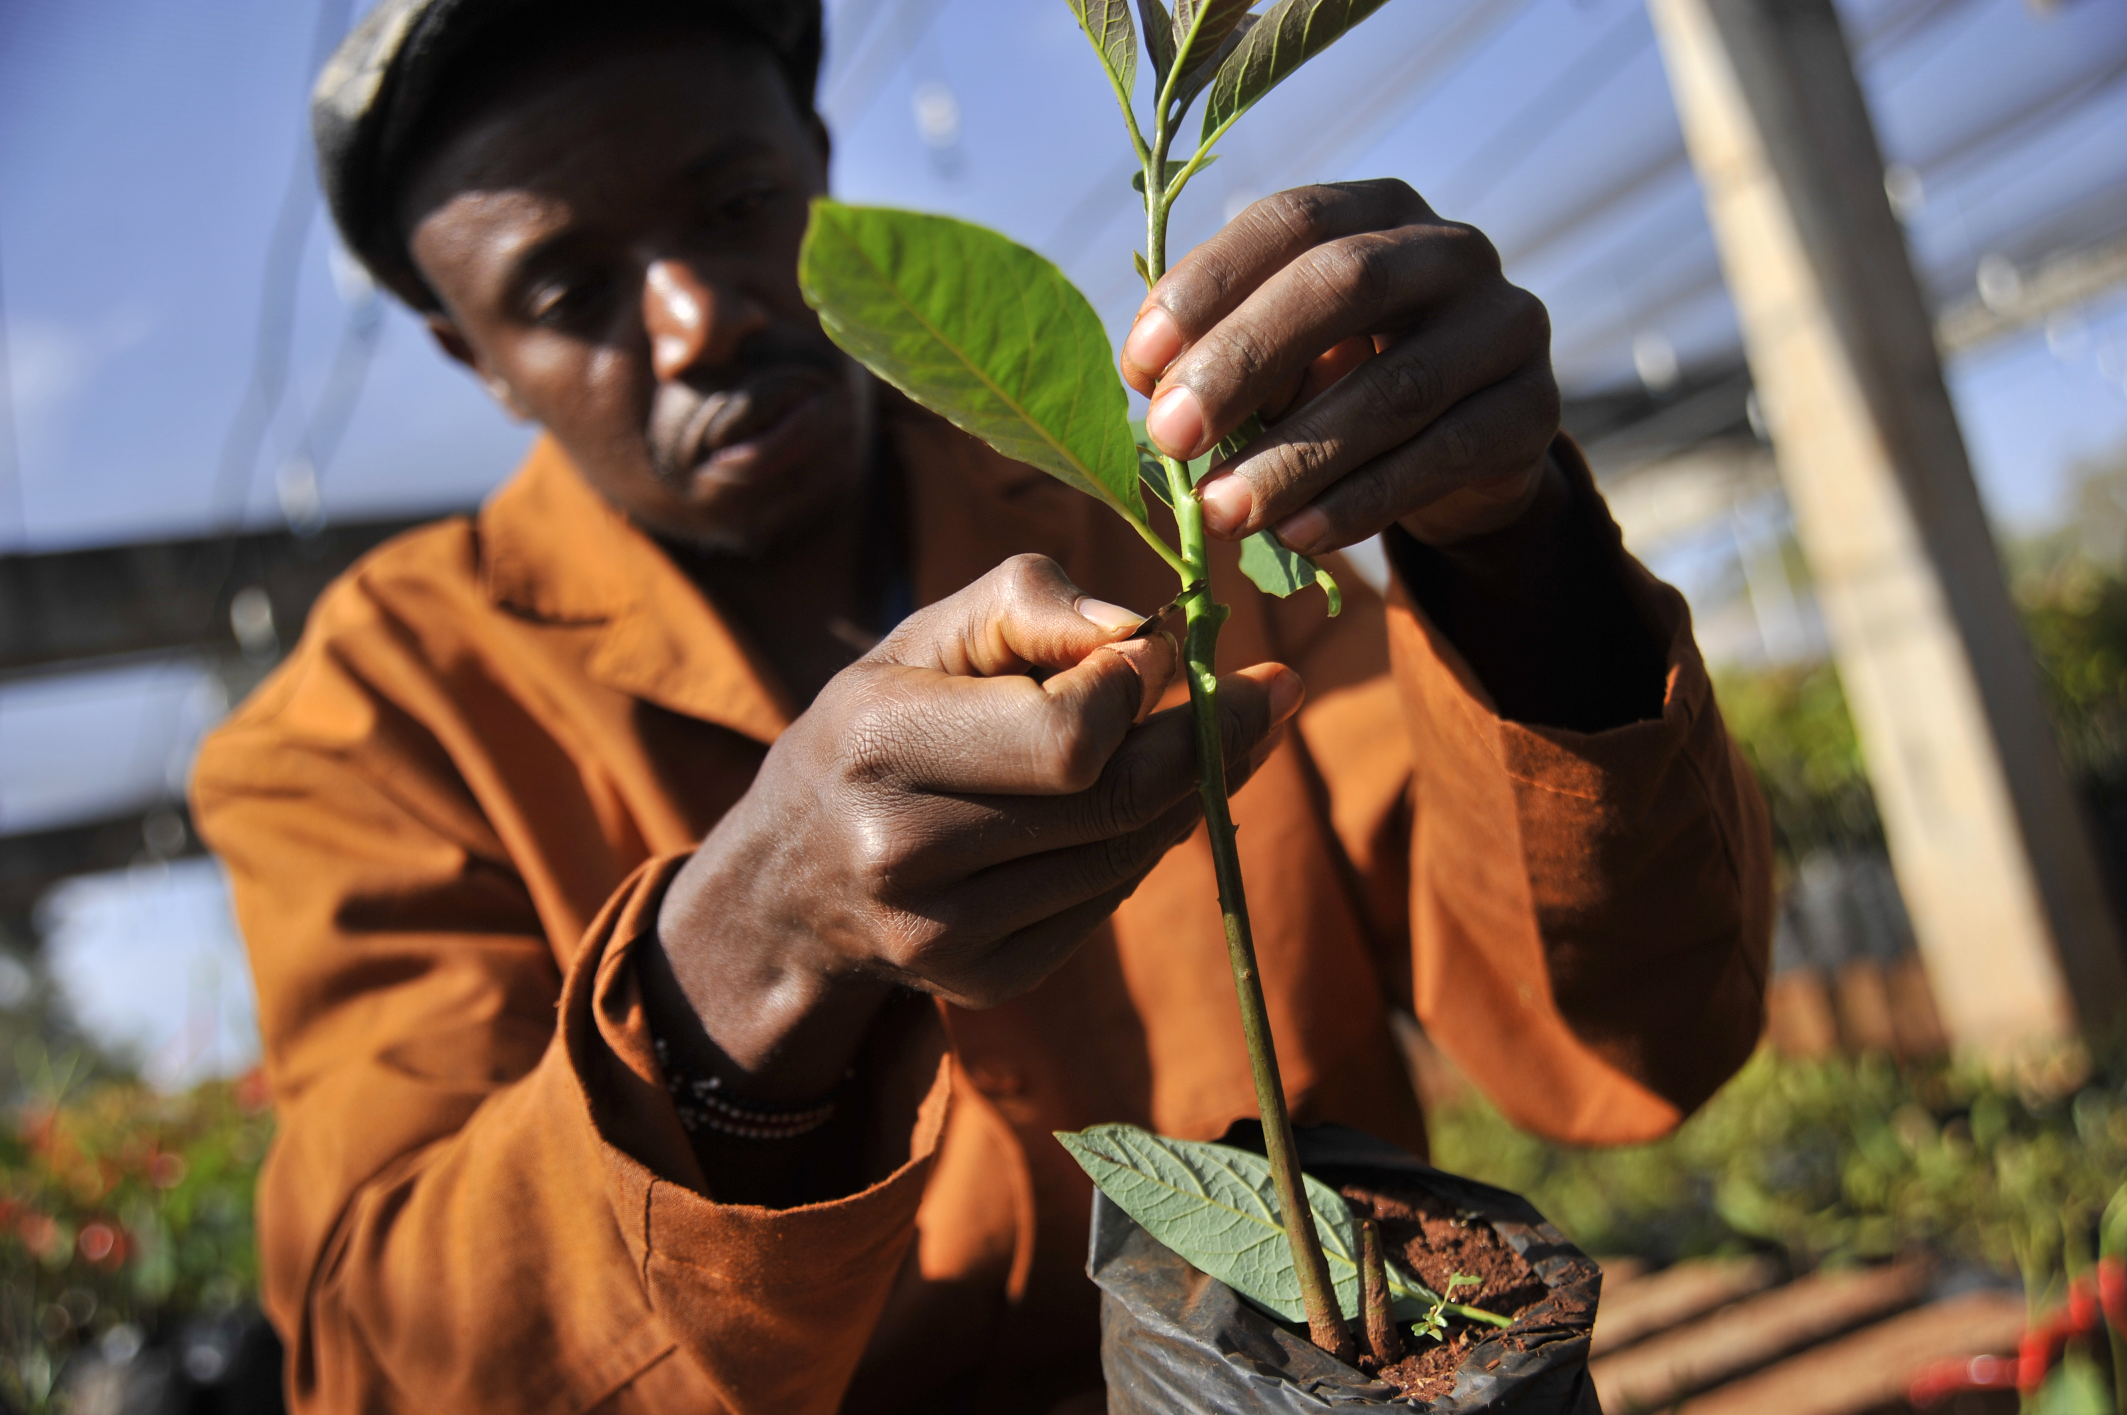
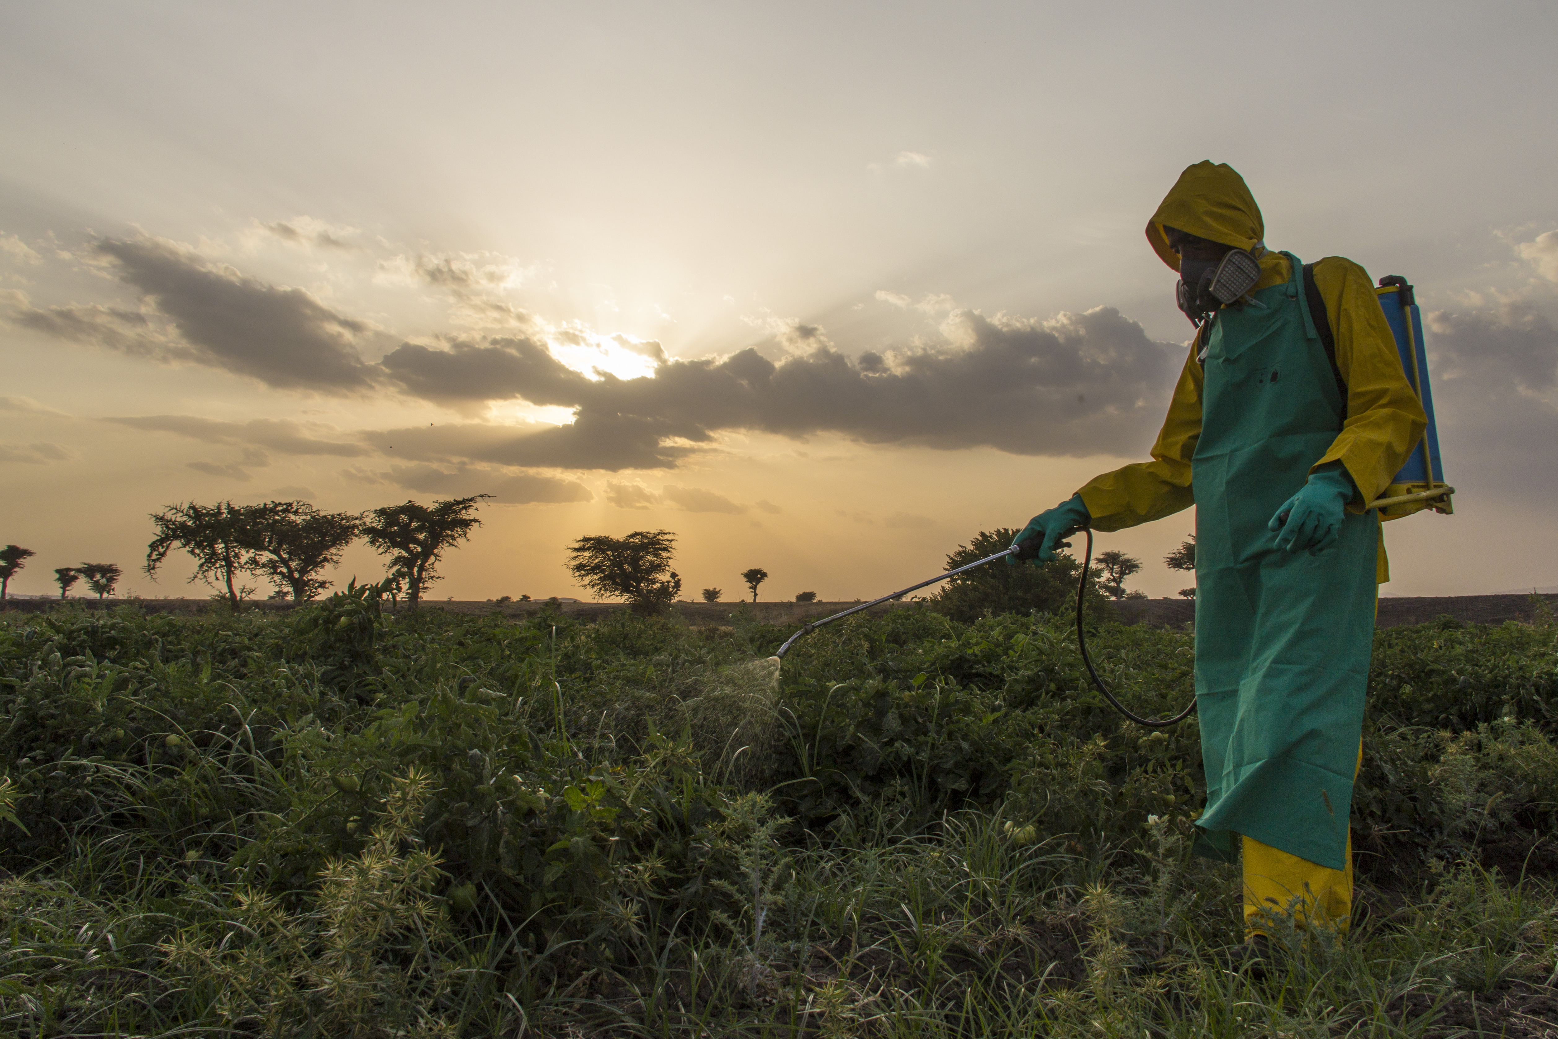
Solutions: Support for Farmers
Agricultural Extension and Farmer Field Schools– pluralistic approaches
Access to Agricultural Inputs and Financing
Photo credit: Riccardo Gangale, USAID
Photo credit: CNFA Ethiopia CFSP

Slide 26
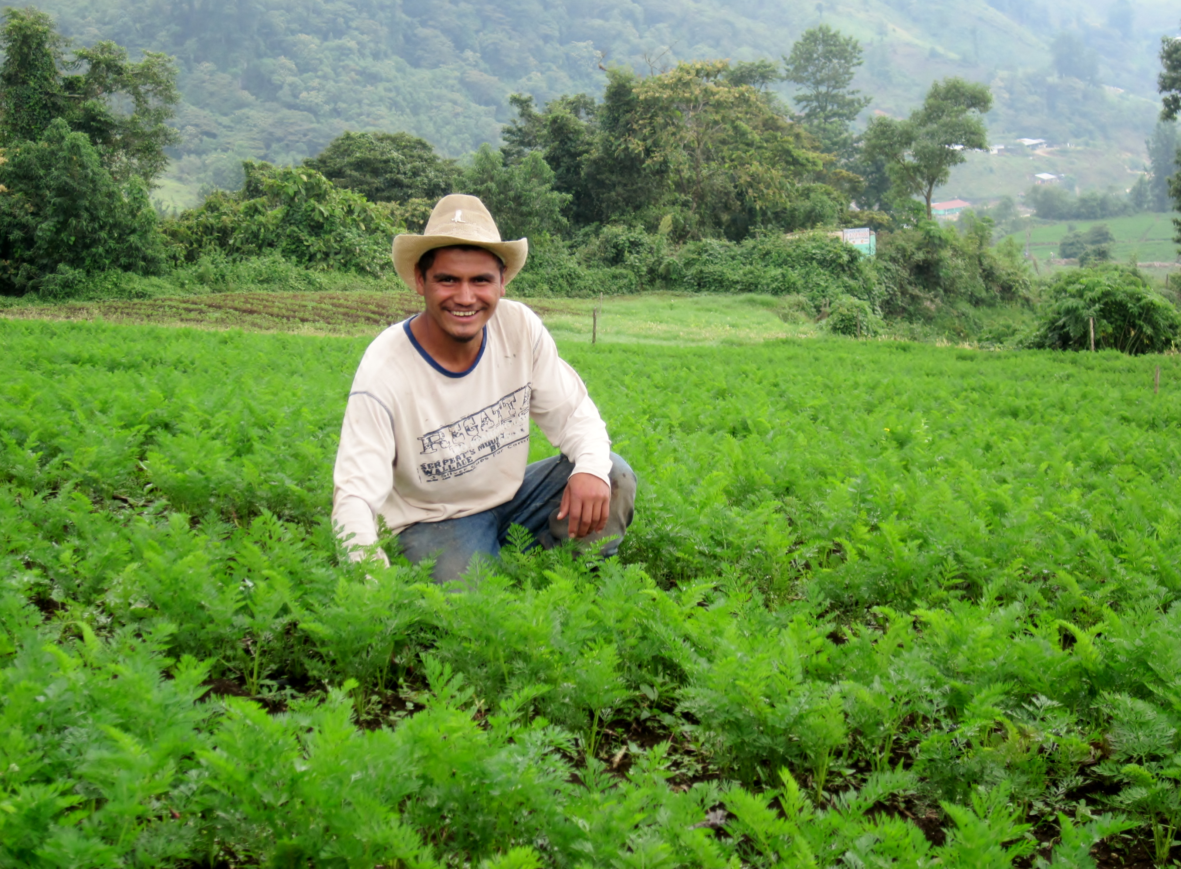
Solutions: Climate-Smart Agriculture
Productivity, Adaptation and Mitigation
No/low till planting
Rainwater retention
Climate-appropriate crops (drought-resistant)
Improved irrigation
Improve storage and processing to reduce waste, improve nutritional quality
Photo credit: Hector Santos, Feed the Future

Slide 27
Solutions: Climate-Smart Agriculture (2)
Productivity, Adaptation and Mitigation
Increasing production on existing lands
Protecting forest from becoming farmland
Reducing crop burning
Encourage proper handling of manure
Replacing fossil fuels with renewable energy

Slide 28
Key Points from This Session
Agriculture is the main source of employment for rural families in the developing world
GDP growth through agriculture is 4X more effective in reducing poverty than growth generated by other sectors
However…
Farming is a risky business that requires sustainable natural resources, capital, labor, knowledge, and technology
Global climate change, food loss and waste, decreasing soil and water quality, and markets driven by changing dietary preferences must be considered when promoting agricultural development.

Slide 29
Key Points from this Session (2)
Using approaches that build consumer demand for improved diets, provide support for farmers and focus on climate-smart techniques will have the best results.
This will lead to increased production, income and sustainability of agricultural livelihoods.
Adapted from FAO Improving Nutrition through Agriculture and Food Systems E-learning Course

Slide 30
References
CGIAR Research Program on Climate Change, Agriculture and Food Security (CCAFS). n.d. “Climate Impact on Production.” Big Facts. https://ccafs.cgiar.org/bigfacts/#theme=climate-impacts-production.
CGIAR Research Program on Climate Change, Agriculture and Food Security (CCAFS). n.d. “Food Waste.” Big Facts, Food Security. https://ccafs.cgiar.org/bigfacts/#theme=food-security&subtheme=food-waste.
FAO. 2013. Statistical Yearbook 2013. Rome: Food and Agriculture Organization of the United Nations.
FAO. 2015. FAO Statistical Pocketbook. Rome: Food and Agriculture Organization of the United Nations.
“Food: The Growing Problem.” 2010. Nature 466 (July): 546–47. https://doi.org/10.1038/466546a.
Foundation on Future Farming. n.d. “Water.” Global Agriculture: Agriculture at a Crossroads, Findings and Recommendations for Future Farming. https://www.globalagriculture.org/report-topics/water.html.
USAID. 2004. USAID Agriculture Strategy: Linking Producers to Markets. Washington, DC: USAID.

Slide 31
Thank you!

