Slide 1
Agriculture-to-Nutrition Pathways
SPRING Nutrition-Sensitive Agriculture Training Resource Package
February 2018
Notes:
Guidance for how to present these slides is included in the SPRING Nutrition-Sensitive Agriculture Training Resource Package Session Guide: Pathways

Slide 2
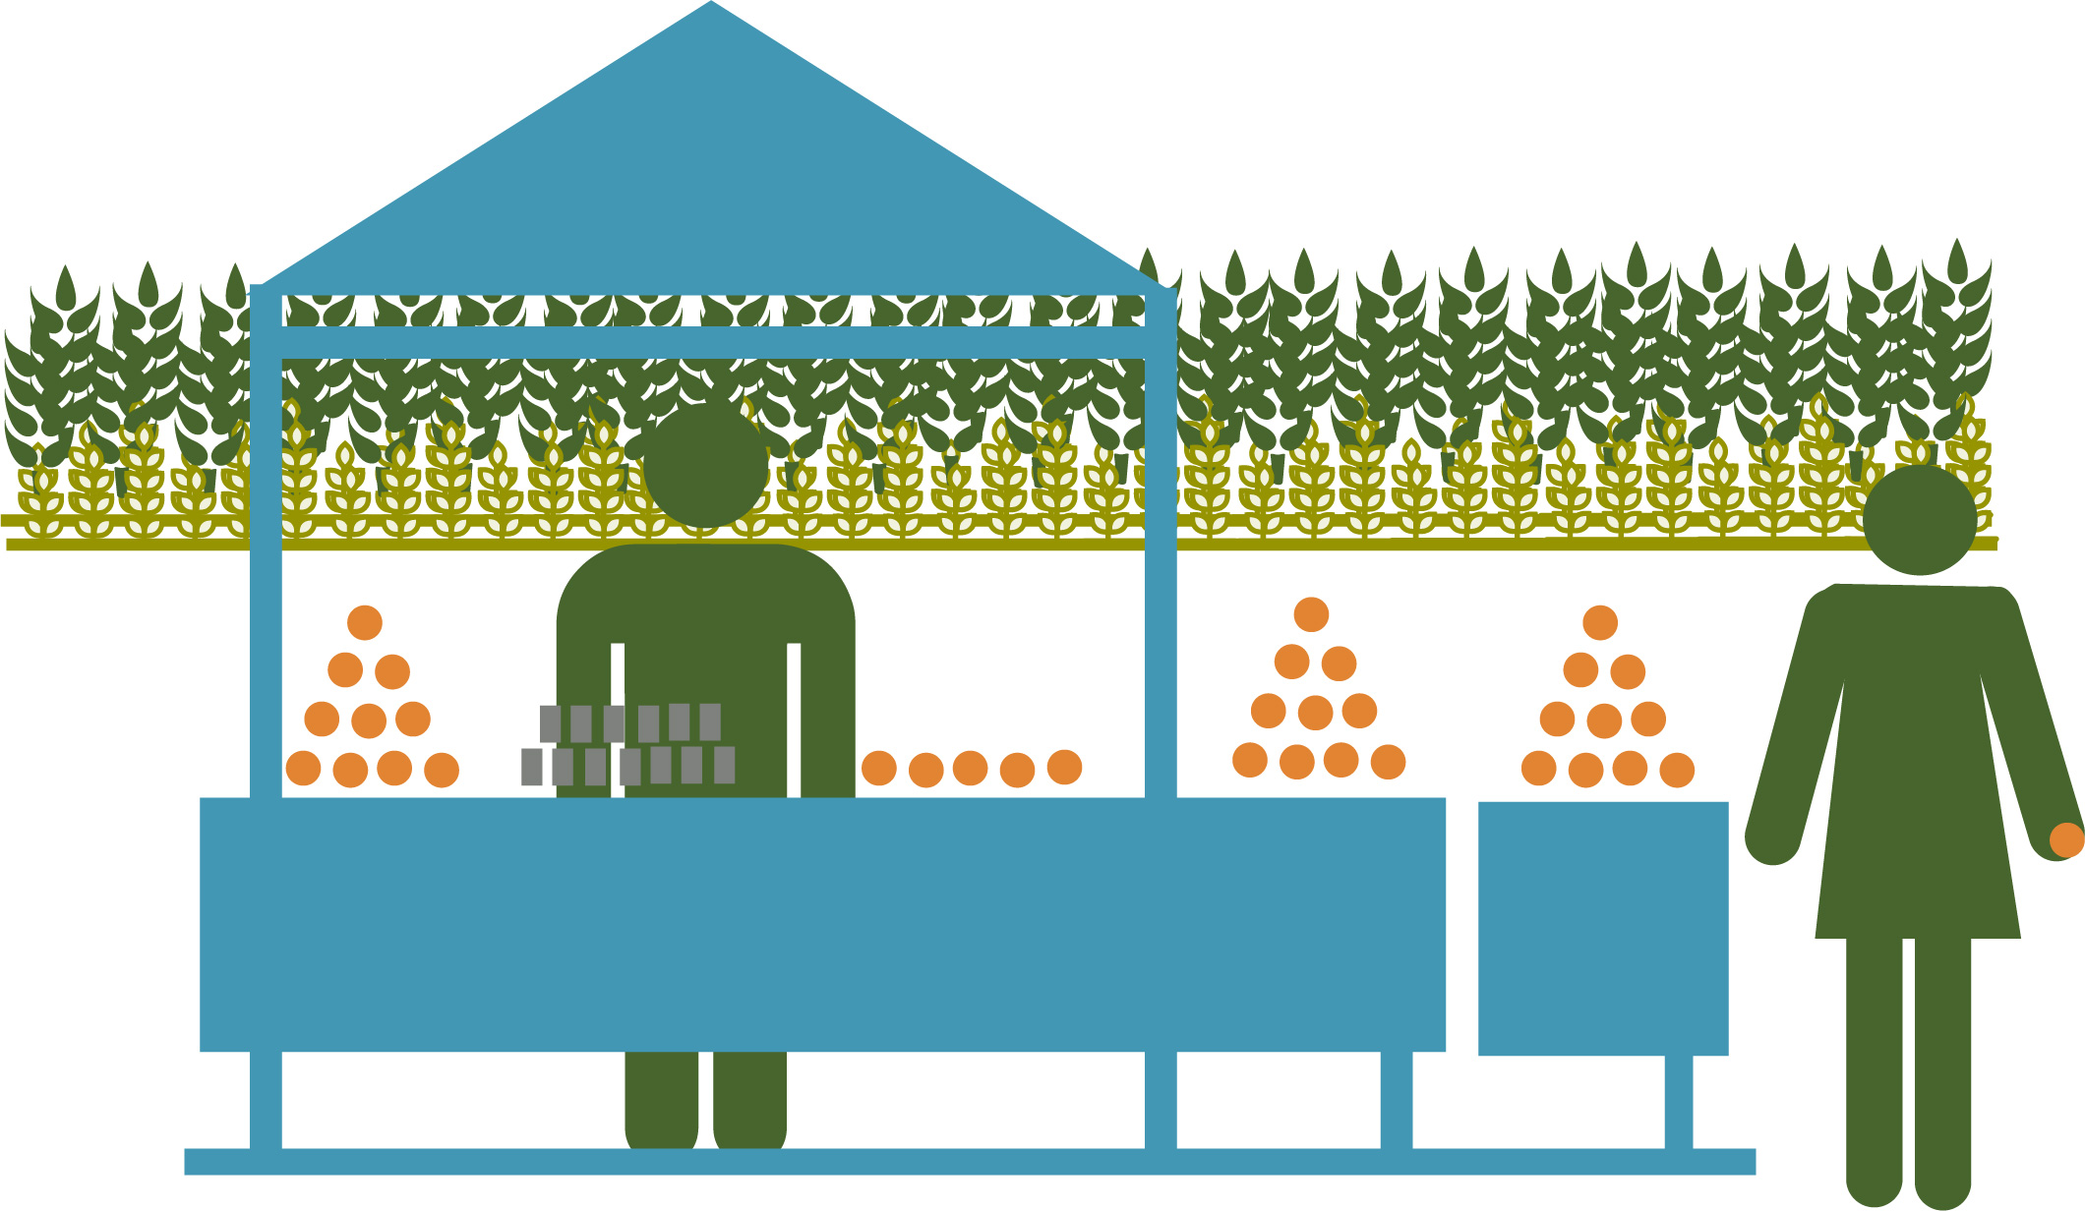
Objectives
Effectively describe the three main pathways and how they overlap
Explain the enabling environment in which all pathways operate
Identify steps along each main pathway to ensure that agriculture activities meet nutrition outcomes

Slide 3
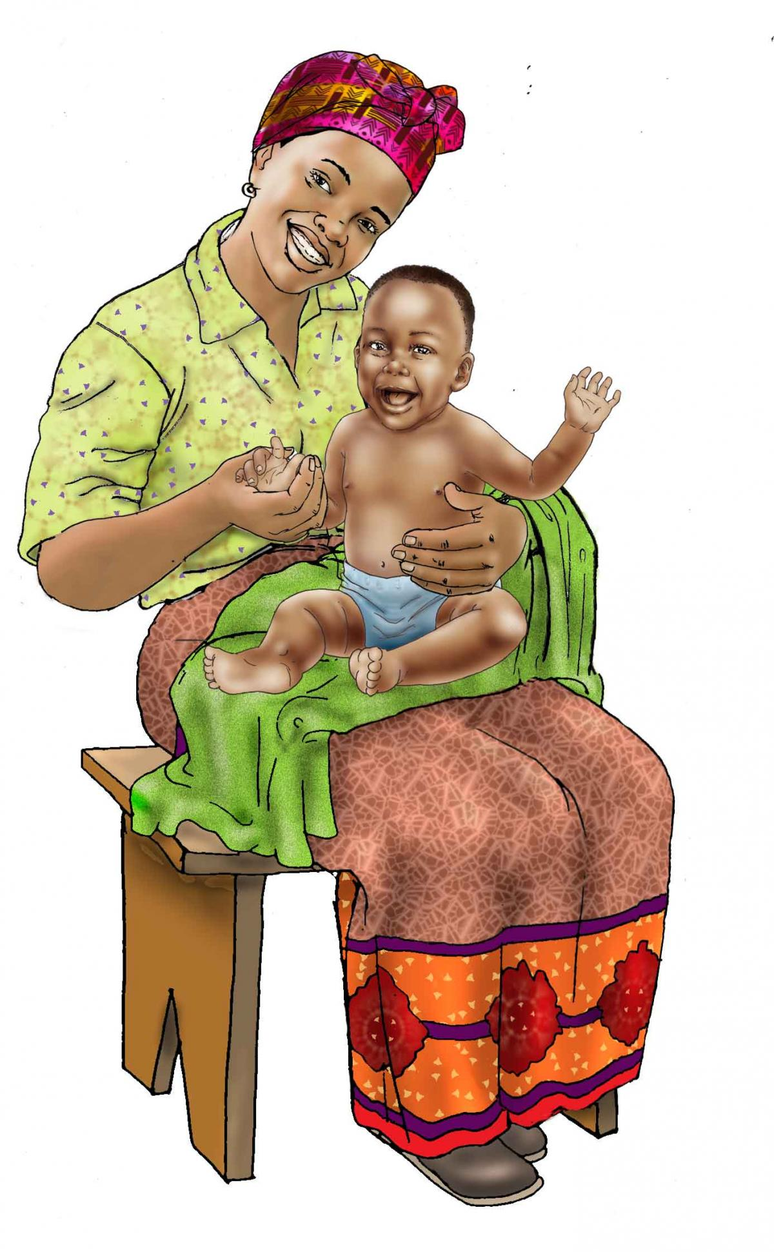
The child’s health is closely linked to the mother’s health.
Image credit: SPRING

Slide 4
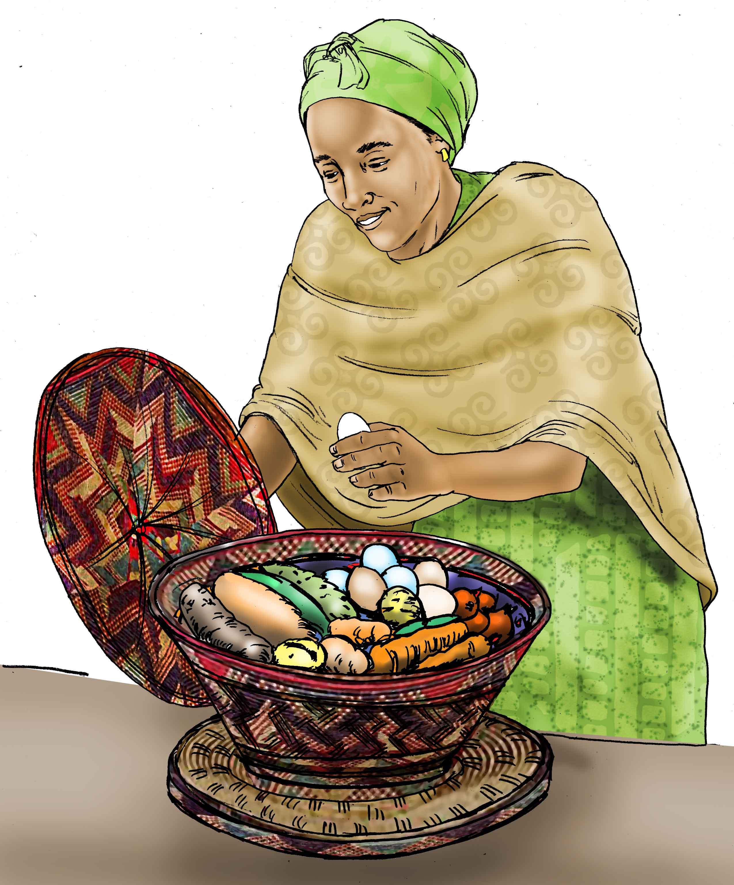
Getting Enough Nutritious Food
Safety Variety Quality Quantity
Image credit: University Research Co., LLC-Center for Human Services (URC-CHS)
Notes:
Photo credit: Tony Gil Arias (Feed the Future Flickr collection)

Slide 5
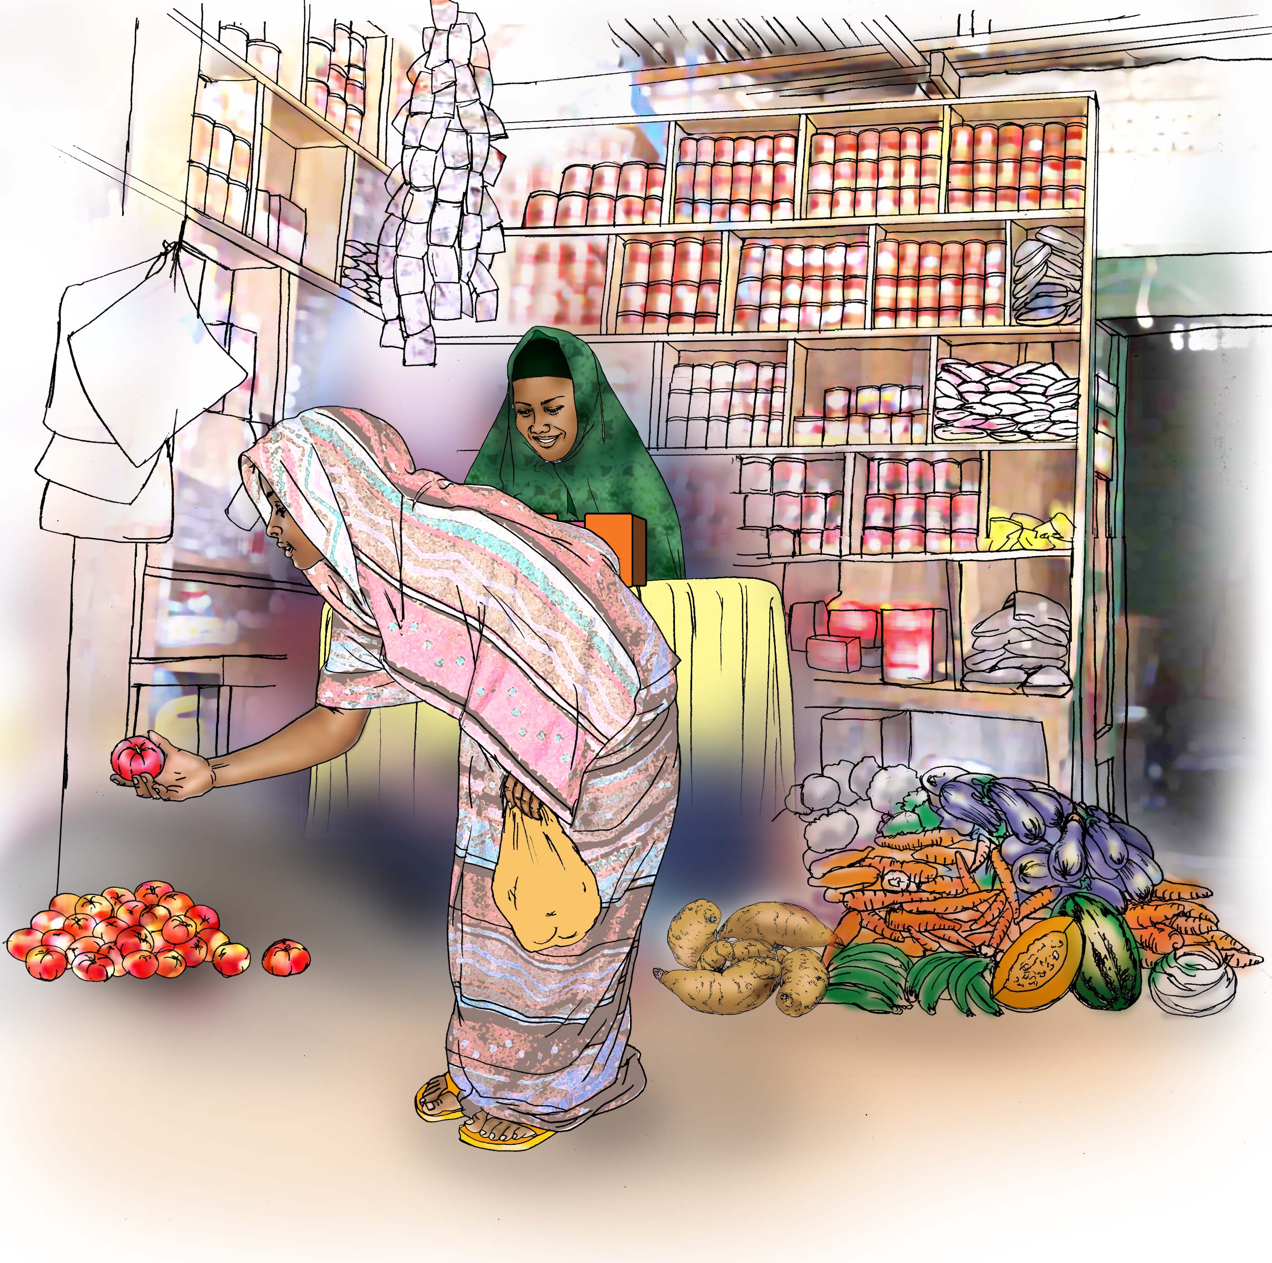
Getting Enough Good Food
Grow & raise
Harvest, process & store
Sell & buy
Image credit: University Research Co., LLC-Center for Human Services (URC-CHS)

Slide 6
Building the agriculture to nutrition story

Slide 7
Agriculture-to-Nutrition Pathways
National Economic Growth
National Nutrition Profile
Key components of the enabling environment:
Food market environment
Natural resources environment
Health, water, and sanitation
Nutrition/health knowledge and norms
Food Production
Food
Prices
Processing
& Storage
Food Expenditure
Food Access
Diet
Child Nutrition Outcomes
Household Assets and Livelihoods
Agricultural Livelihoods
Agricultural Income
Non-food Expenditure
Health
Care
Health
Status
Mother’s Nutrition Outcomes
Time
Women’s Empowerment
Caring Capacity & Practices
Energy Expenditure
Headey, D., Chiu, A., & Kadiyala, S. (2011). Agriculture’s role in the Indian enigma: Help or hindrance to the undernutrition crisis?: IFPRI discussion paper 01085. Washington, DC: IFPRI.
Kadiyala S, Harris J, Headey D, Yosef S, Gillespie S., Agriculture and nutrition in India: mapping evidence to pathways., Ann N Y Acad Sci. 2014 Dec;1331:43-56.

Slide 8
The Main Agriculture-to-Nutrition Pathways
Food Production
Agricultural Income
Women’s Empowerment

Slide 9
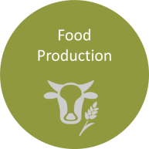
Agriculture as a Source of Food
Decisions about what to produce are influenced by:
Market prices
Relative costs/risks
Productive assets,
Preferences
Cultural norms
The ability to effectively process and store food affects:
Shelf-life and safety of the food
Nutrient content
Access to food during lean times

Slide 10
Doña Brito in Guatemala: An Example of the Food Production Pathway
Guatemala
Photo credit: Save the Children

Slide 11
Steps on the Food Production Pathway
National Economic Growth
National Nutrition Profile
Key components of the enabling environment:
Food market environment
Natural resources environment
Health, water, and sanitation
Nutrition/health knowledge and norms
Food Production
Food
Prices
Processing
& Storage
Food Expenditure
Food Access
Diet
Child Nutrition Outcomes
Household Assets and Livelihoods
Agricultural Livelihoods
Agricultural Income
Non-food Expenditure
Health
Care
Health
Status
Mother’s Nutrition Outcomes
Time
Women’s Empowerment
Caring Capacity & Practices
Energy expenditure

Slide 12
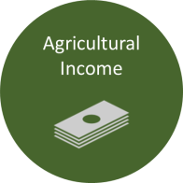
Agriculture as a Source of Income
Improved year-round income and cash flow to meet household needs, including diverse, nutritious foods
Assumes nutritious foods are available in markets; reflects the importance of generating demand and need for nutrition education

Slide 13
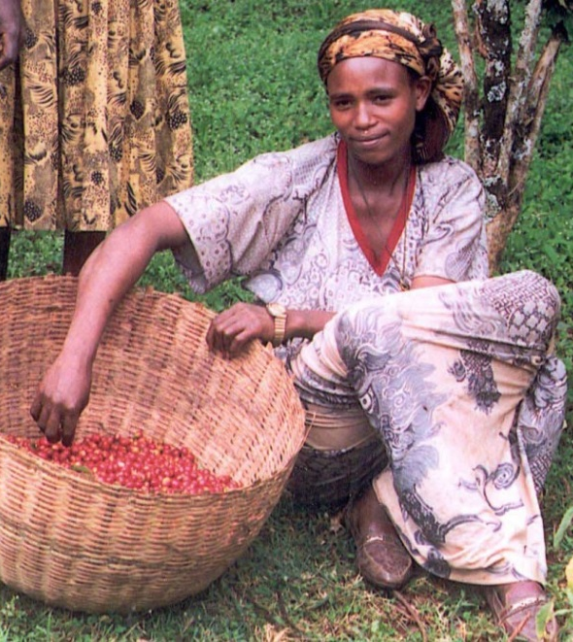
Netsanet in Ethiopia: An Example of the Agricultural Income Pathway
Ethiopia
Photo credit: Feed the Future

Slide 14
Steps on the Income Pathway
National Economic Growth
National Nutrition Profile
Key components of the enabling environment:
Food market environment
Natural resources environment
Health, water, and sanitation
Nutrition/health knowledge and norms
Food Production
Food
Prices
Processing
& Storage
Food Expenditure
Food Access
Diet
Child Nutrition Outcomes
Household Assets and Livelihoods
Agricultural Livelihoods
Agricultural Income
Non-food Expenditure
Health
Care
Health
Status
Mother’s Nutrition Outcomes
Time
Women’s Empowerment
Caring Capacity & Practices
Energy expenditure

Slide 15
Agriculture as a Means to Women’s Empowerment
Women’s access to income is considered more often than time and energy use.
Women are more likely to spend added income on the health and nutritional needs of the household.

Slide 16
Pakhtakor Village in Tajikistan: An Example of the Women’s Empowerment Pathway
Tajikistan
Photo credit: SPRING

Slide 17
Steps on the Women’s Empowerment Pathway
National Economic Growth
National Nutrition Profile
Key components of the enabling environment:
Food market environment
Natural resources environment
Health, water, and sanitation
Nutrition/health knowledge and norms
Food Production
Food
Prices
Processing
& Storage
Food Expenditure
Food Access
Diet
Child Nutrition Outcomes
Household Assets and Livelihoods
Agricultural Livelihoods
Agricultural Income
Non-food Expenditure
Health
Care
Health
Status
Mother’s Nutrition Outcomes
Time
Women’s Empowerment
Caring Capacity & Practices
Energy expenditure

Slide 18
Pathways in Context: Enabling Environment
National Economic Growth
National Nutrition Profile
Key components of the enabling environment:
Food market environment
Natural resources environment
Health, water, and sanitation
Nutrition/health knowledge and norms
Food Production
Food
Prices
Processing
& Storage
Food Expenditure
Food Access
Diet
Child Nutrition Outcomes
Household Assets and Livelihoods
Agricultural Livelihoods
Agricultural Income
Non-food Expenditure
Health
Care
Health
Status
Mother’s Nutrition Outcomes
Time
Women’s Empowerment
Caring Capacity & Practices
Energy Expenditure
Headey, D., Chiu, A., & Kadiyala, S. (2011). Agriculture’s role in the Indian enigma: Help or hindrance to the undernutrition crisis?: IFPRI discussion paper 01085. Washington, DC: IFPRI.
Kadiyala S, Harris J, Headey D, Yosef S, Gillespie S., Agriculture and nutrition in India: mapping evidence to pathways., Ann N Y Acad Sci. 2014 Dec;1331:43-56.

Slide 19
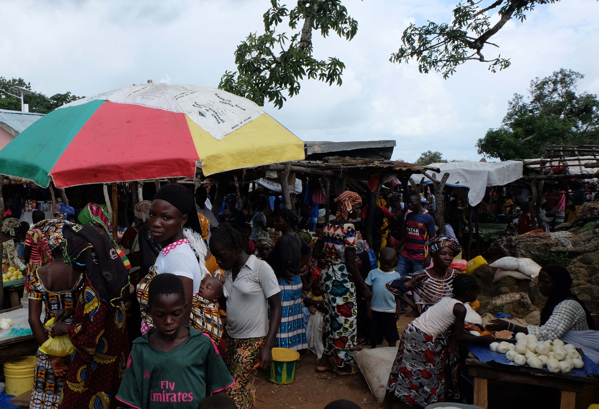
The Enabling Environment
Food Market Environment
Natural Resources Environment
Health, Water and Sanitation
Nutrition/Health Knowledge and Norms
Photo credit: Sarah Hogan, SPRING

Slide 20
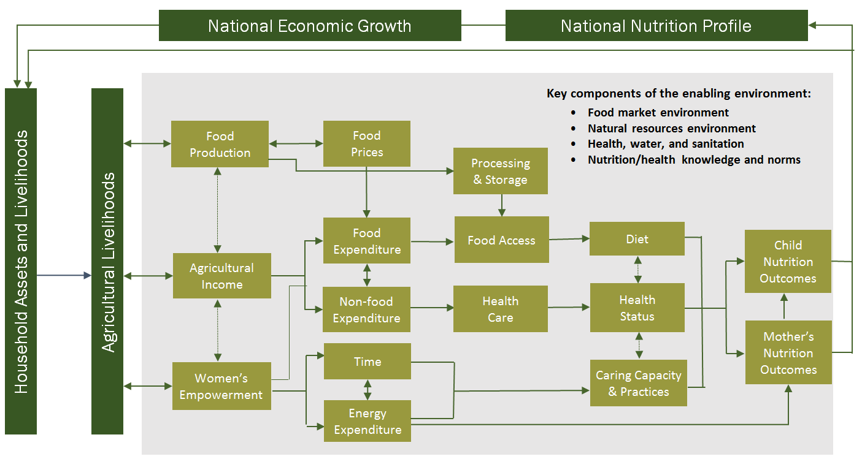
Linking Agriculture and Nutrition
The Pathways framework guides us to:
Design nutrition-sensitive agriculture activities
Drive toward nutrition-based outcomes
Use indicators that connect with a range of steps along the pathways
Headey, D., Chiu, A., & Kadiyala, S. (2011). Agriculture’s role in the Indian enigma: Help or hindrance to the undernutrition crisis?: IFPRI discussion paper 01085. Washington, DC: IFPRI.
Kadiyala S, Harris J, Headey D, Yosef S, Gillespie S., Agriculture and nutrition in India: mapping evidence to pathways., Ann N Y Acad Sci. 2014 Dec;1331:43-56.

Slide 21
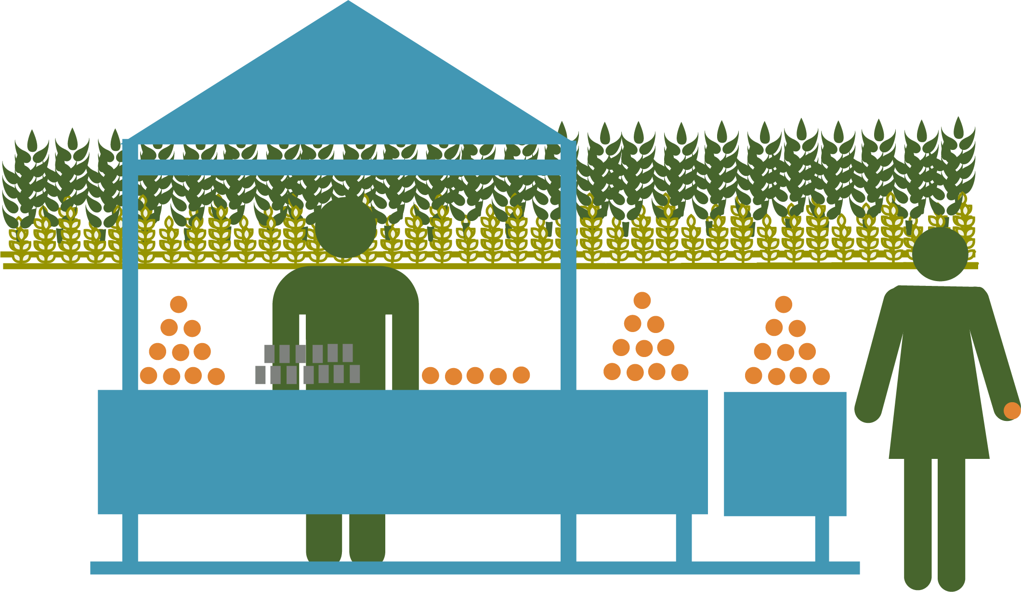
Key Points from This Session
Good nutrition includes getting the right quantity of good quality, diverse foods all year. These foods must be handled and stored safely to avoid causing illness.
The Agriculture-to-Nutrition Pathways describe actions that lead to better maternal and child health.
The three pathways: food production, agricultural income, and women’s empowerment are overlapping and intertwined.

Slide 22
Key Points from This Session (2)
Each pathway is impacted by the enabling environment, which includes the food market environment, natural resource environment, health/water/sanitation and nutrition/health knowledge and norms.

Slide 23
Thank you!

